Slide 1
Azure Networking Deep Dive
<presenter>

Slide 2

How to use this deck
Browse linearly, or use the Contents Slide to jump to each individual section
From each slide in the deck you can return to the Contents Slide clicking on the symbol
There are 200+ slides in this deck, so if time is limited the recommendation is to cover only those topics of interest for the audience
In each section title you can find a link to documentation

Slide 3
Content
Traffic Manager
Azure DNS
Routing Deep Dive
NVAs
Automation
Monitoring
Virtual Networks
Load Balancer
Application Gateway
Network Security Groups
Cross-Premises
Active-Active VPN Gateways
ExpressRoute Deep Dive
Connecting Vnets
With S2S VPN
Vnet Peering

Slide 4
Vnets and Subnets

Slide 5
Virtual Network
Isolated, logical network that provides connectivity for Azure Virtual Machines
User-defined address space (can be one or more IP ranges, not necessarily RFC1918)
1. Connectivity for VMs in the same VNet
2. Connectivity to external networks/on-prem DC’s
3. Internet connectivity
Internet
3. Internet
Name: VNet1
Address space: 10.57.0.0/16, 10.66.0.0/24
2. On Prem
VM
1. Intra-VNET
VM

Slide 6
Subnet
IP subnet
Provides full layer-3 semantics and partial layer-2 semantics (DHCP, ARP*, no broadcast/multicast)
Subnets can span only one range of contigous IP addresses
VMs can be deployed only to subnets (not VNets)
Name: VNet1
Address space: 10.57.0.0/16, 10.66.0.0/24
Subnet1
10.57.1.0/24
Subnet2
10.66.0.0/24
VM1
VM4
VM5
VM3
VM2
VM6
VM7
* ARP requests are always answered by the vnet router with its own IP address

Slide 7
Network Interface
Virtual NIC that connects a VM to a Subnet
One private IP address (private == included in the subnet’s IP range, not necessarily RFC1918)
Private IP address always assigned via Azure DHCP
Dynamic assignment = DHCP assigns new IP when VM is restarted
Static assignment =DHCP assigns always the same IP
IP forwarding = NIC can receive packets with dest IP address different from its private IP
Public IP = NAT address associated to the NIC (more on this later). AKA «VIP»
Virtual machine
Private IP
«DIP»
NIC
Assignment=static/dynamic
IP Forwarding=yes/no
Public IP=<public IP>
Attached to Subnet

Slide 8
Network Interface
Virtual NIC that connects a VM to a Subnet
One private IP address (private == included in the subnet’s IP range, not necessarily RFC1918)
Private IP address always assigned via Azure DHCP
Dynamic assignment = DHCP assigns new IP when VM is restarted
Static assignment =DHCP assigns always the same IP
IP forwarding = NIC can receive packets with dest IP address different from its private IP
Public IP = NAT address associated to the NIC (more on this later). AKA «VIP»
Virtual machine
Private IP
«DIP»
NIC
Assignment=static/dynamic
IP Forwarding=yes/no
Public IP=<public IP>
IpConfiguration
Attached to Subnet

Slide 9
Network Interface
Announced @Ignite2016
NICs can have more than one IpConfiguration
Each private IP can be associated to a public IP address
One “primary” private IP, multiple “secondary” private IPs
Primary IP assigned by Azure DHCP; secondary IPs configured in guest OS
Public
Preview
Virtual NIC that connects a VM to a Subnet
One private IP address (private == included in the subnet’s IP range, not necessarily RFC1918)
Private IP address always assigned via Azure DHCP
Dynamic assignment = DHCP assigns new IP when VM is restarted
Static assignment =DHCP assigns always the same IP
IP forwarding = NIC can receive packets with dest IP address different from its private IP
Public IP = NAT address associated to the NIC (more on this later). AKA «VIP»
Virtual machine
NIC
Assignment=static/dynamic
IP Forwarding=yes/no
Public IP=<public IP>
Assignment=static/dynamic
IP Forwarding=yes/no
Public IP=<public IP>
Private IP
Private IP
IpConfiguration

Slide 10
Switching/Routing in Azure VNets
A VNet provides a switching/routing functionality that allows VMs to talk to each other
Name: VNet2
Address space: 10.57.0.0/16
Subnet1
10.57.1.0/24
Subnet2
10.57.2.0/25
VM1
VM4
VM3
VM5
VM2
VM6
Switch/Routing
(Azure VM Switch)

Slide 11

Switching/Routing in Azure VNets
A VNet provides a switching/routing functionality that allows VMs to talk to each other
Name: VNet2
Address space: 10.57.0.0/16
Please note that, in an Azure VNet, packets can flow between to different subnets without explicitly traversing any layer-3 device. Azure’s network virtualization stack effectively works as a layer-3 switch
Subnet1
10.57.1.0/24
Subnet2
10.57.2.0/25
VM1
VM4
VM3
VM5
VM2
VM6
Switch/Routing
(Azure VM Switch)

Slide 12
Internet access from a VM
Azure provides default internet access via NAT
Internet Host
IP = 1.2.3.4
Name: VNet2
Address space: 10.57.0.0/16
Internet
Subnet1
10.57.1.0/24
Subnet2
10.57.2.0/25
VM1
VM4
VM3
VM5
10.57.2.7
All VMs source-NATted to a non-configuratble public IP address
VM2
VM6
Switch/router (Azure VM Switch)
Azure WAN

Slide 13
Internet access to a VM
Azure provides public access via a public IP + NAT
Internet Host
IP = 1.2.3.4
Name: VNet2
Address space: 10.57.0.0/16
Internet
Subnet1
10.57.1.0/24
Subnet2
10.57.2.0/25
VM5 NIC’s public IP
40.112.124.15 (also used for outgoing traffic, instead of the default public IP address)
VM1
VM4
VM3
VM5
10.57.2.7
VM2
VM6
Switch/router (Azure VM Switch)
Azure WAN

Slide 14
Latest announcements
https://azure.microsoft.com/de-de/updates/ipv6-for-azure-vms/
https://azure.microsoft.com/en-us/roadmap/multiple-ip-addresses-on-network-interface-cards-nic/
https://azure.microsoft.com/en-us/blog/new-networking-features-in-azure-scale-sets/

Slide 15
IPv6 Support

Slide 16
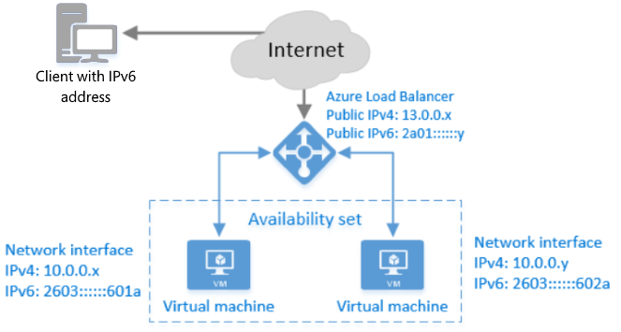
IPv6 for Azure LB: North-South IPv6
IPv6 VIPs
6to4, dual-stack, native IPv6 connections
https://docs.microsoft.com/en-us/azure/load-balancer/load-balancer-ipv6-overview

Slide 17
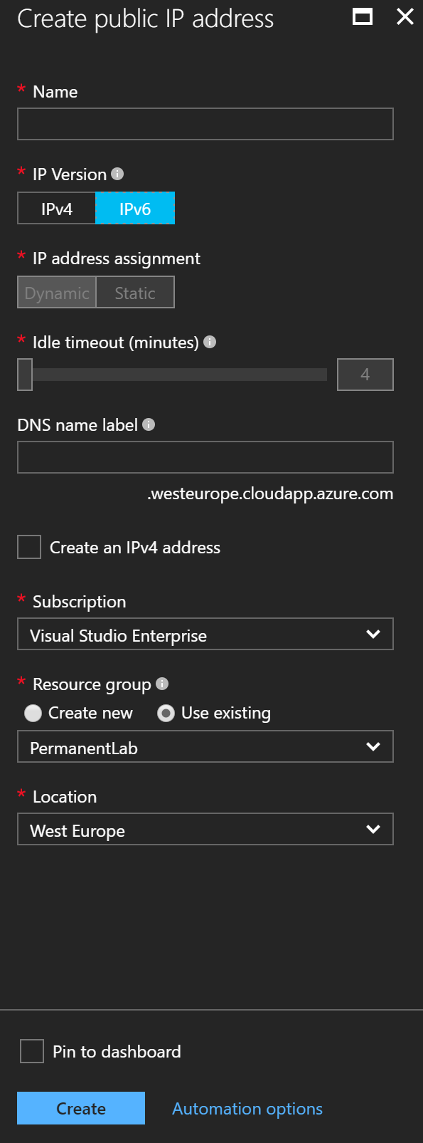
Public IPv6 addresses
Main construct to enable North-South IPv6

Slide 18
Azure Load Balancer
https://docs.microsoft.com/en-us/azure/load-balancer/

Slide 19
Azure Load Balancer scenarios
1. Inbound NAT rules
Port mapping
Availability set
DIP1, port W
Azure VM
VIP, port X
Load Balancer
Azure VM
VIP, port Y
VIP, port Z
DIP2, port W
Azure VM
DIP3, port W

Slide 20
Azure Load Balancer scenarios
1. Inbound NAT rules - Example
RDP access to multiple VMs through single VIP
Availability set
DIP1, port 3389
Azure VM
VIP, port 57001
Load Balancer
Azure VM
VIP, port 57002
VIP, port 57003
DIP2, port 3389
Azure VM
DIP3, port 3389

Slide 21
Azure Load Balancer scenarios
2. Load balancing
Load distribution
Availability set
DIP1, port Y
Azure VM
round robin
Load Balancer
Azure VM
VIP, port X
DIP2, port Y
Azure VM
DIP3, port Y

Slide 22
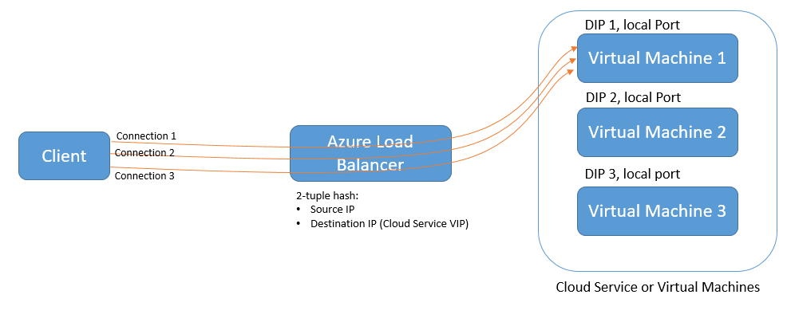
Azure Load Balancer scenarios
Load balancing rules – Distribution modes

Slide 23
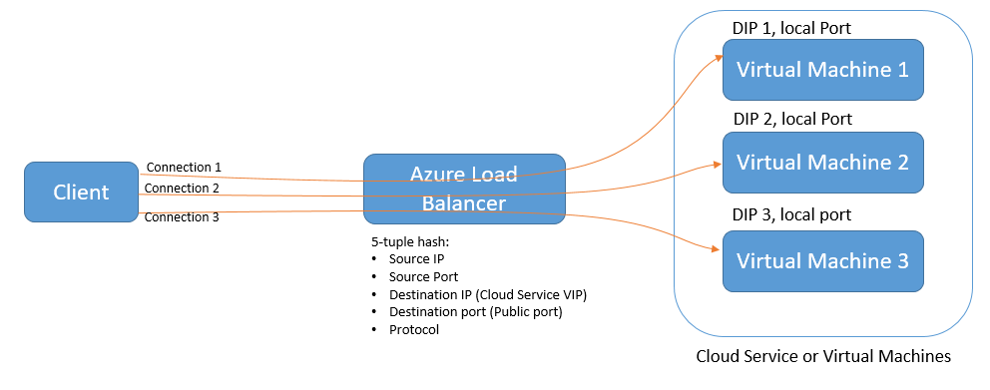
Azure Load Balancer scenarios
Load balancing rules – Distribution modes

Slide 24
Azure Load Balancer architecture
Availability set
VIP-1
Azure VM
Frontend IP
Config 1
Inbound NAT rules
Backend pool 1
Azure VM
VIP-2
Frontend IP
Config 2
Backend pool 2
Load balancing rules
:
:
:
:
Azure VM
Azure VM
Probes
VIP-N
Frontend IP
Config N
Backend pool
M
Azure VM

Slide 25
Azure Load Balancer architecture
All backend pools must contain VMs from one availability set only
Rules connect a VIP to a pool of VMs
Backend pools are sets of VMs to which traffic must be distributed
Availability set
VIP-1
Azure VM
Frontend IP
Config 1
Inbound NAT rules
Backend pool 1
VIP-2
Azure VM
Frontend IP
Config 2
Backend pool 2
:
:
Load balancing rules
Azure VM
:
:
Azure VM
VIP-N
Probes
Frontend IP
Config N
Backend pool
M
Azure VM
A load balancer can have multiple VIPS
A VM may belong to more than one backend pool
Probes check availability of TCP/UDP endpoints

Slide 26
Azure Load Balancer
Internet-facing vs. internal
VIP is a private IP address assigned from a Vnet’s address range
VIP is a PUBLIC IP Address
Availability set
Availability set
Azure VM
Azure VM
Internal load balancer
Azure VM
Internet-facing load balancer
Azure VM
Azure VM
Azure VM

Slide 27
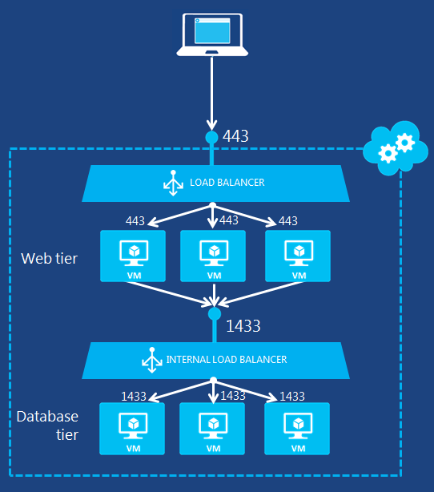
Azure Load Balancer
Internet-facing vs. internal

Slide 28
Azure Load Balancer improvements
Announced @Ignite 2016
GA: multiple VIPs on internal load balancers
Public Preview: attach load balancers to all of a VM’s NICs (currently: only “primary” NIC)
Public Preview: assign public IP address to all of a VM’s NICs (always through a load balancer)

Slide 29
Azure Application Gateway
https://docs.microsoft.com/en-us/azure/application-gateway/

Slide 30
Application Gateway key facts
Publish HTTP(S) applications (internet or in a VNet)
TLS termination/offloading
Load balancing across multiple backend instances with cookie-based session affinity
(Optional) Web application firewalling based on Apache’s ModSecurity

Slide 31
Deploying Application Gateways
Dedicated subnet is required
Dedicated subnet must be large enough to contain the configured number of instances + 1
HA & horizontal scalability: up to 10 instances
Vertical scalability: Small, Medium, Large instances
At most 1 public VIP and 1 private VIP
Private VIP must be in the application gateway subnet
Name: VNet2
Address space: 10.57.0.0/16
Subnet1
10.57.1.0/24
MyAGWsubnet
10.57.2.0/28
Internal VIP
10.57.2.13
VM1
VM3
Application
Gateway
VM2
Switch/router (Azure VM Switch)
Azure Load Balancer
Public VIP
40.112.124.15

Slide 32
Resource-level view
Application Gateway
Public Frontend IP
Config
Listener
HTTP settings
Custom Probe
Backend Pool
Web Server
Public VIP
Listener
HTTP settings
Custom Probe
Backend Pool
HTTP(S) requests from outside the VNet
Web Server
:
:
:
:
:
:
:
:
Private
Frontend IP
Config
Web Server
Private VIP
Listener
HTTP settings
Custom Probe
Backend Pool
Web Server
HTTP(S) requests from the VNet
Rule
Web Server
Rule
Rule

Slide 33
Resource-level view – Frontend IP Configs
Define the VIPs that will receive the HTTP(S) request to be distributed to web servers
Max 1 internet-facing VIP
Max 1 internal VIP
Application Gateway
Public Frontend IP
Config
Listener
HTTP settings
Custom Probe
Backend Pool
Web Server
Listener
HTTP settings
Custom Probe
Backend Pool
Web Server
:
:
:
:
:
:
:
:
Private
Frontend IP
Config
Web Server
Listener
HTTP settings
Custom Probe
Backend Pool
Web Server
Rule
Web Server
Rule
Rule

Slide 34
Resource-level view – Listeners
Listeners receive inbound requests
Listeners are associated to one Frontend IP Config, and one only
Listeners bind to a specific port of the associated VIP
Each listener can receive requests for a specific protocol (HTTP or HTTPS)
Application Gateway
Public Frontend IP
Config
Listener
HTTP settings
Custom Probe
Backend Pool
Web Server
Listener
HTTP settings
Custom Probe
Backend Pool
Web Server
:
:
:
:
:
:
:
:
Private
Frontend IP
Config
Web Server
Listener
HTTP settings
Custom Probe
Backend Pool
Web Server
Rule
Web Server
Rule
Rule

Slide 35
Basic vs. Multi-site listeners
What’s the difference?
Basic listeners process all the requests received over the port they bind to, and matching their configured protocol
Multi-site listeners only process requests received over the port they bind to, matching their configured protocol and matching a specific hostname
Different multi-site listeners for the same protocol can bind to the same frontend IP/port. This allows publishing different web applications on the same (public or private) VIP

Slide 36
Basic vs. Multi-site listeners
Example
Basic HTTPS Listener
Port: 443
Cert: cert#1
Public VIP, port 443
https://www.contoso.com/
Public Frontend IP
Config
Multi-site HTTPS Listener
Port: 443
Hostname: partners.contoso.com
Cert: cert#2
https://partners.contoso.com/login
https://fteportal.contoso.com/home
Multi-site HTTPS Listener
Port: 443
Hostname: fteportal.contoso.com
Cert: cert#3

Slide 37
Basic vs. Multi-site listeners
Example
Multiple listeners can bind on the same port, but only one can be a basic listener
When more than one listeners bind to the same port, multi-site listeners receive requests matching their configured hostname; the basic listener receives the requests that do not match the configured hostname of any multisite listeners on the same port
Each HTTPS multisite listener can be configured with a certificate that matches its configured hostname
Basic HTTPS Listener
Port: 443
Cert: cert#1
Public VIP, port 443
https://www.contoso.com/
Public Frontend IP
Config
Multi-site HTTPS Listener
Port: 443
Hostname: partners.contoso.com
Cert: cert#2
https://partners.contoso.com/login
https://fteportal.contoso.com/home
Basic HTTPS Listener
Port: 443
Hostname: fteportal.contoso.com
Cert: cert#3

Slide 38
Basic vs. Multi-site listeners
Server Name Indication (SNI)
HTTPS = HTTP packets encapsulated in TLS packets
TLS connections must be negotiated before seeing the first HTTP request. How can the application gateway select the right listener and the right certificate before seeing the hostname in the first HTTP request?
SNI is an extension to the TLS protocol whereby the hostname of the HTTP requests to be encapsulated in TLS packets is sent in advance by the client to the server, while negotiating the TLS connection
SNI support must be present on both client- and server-side. Most modern browsers include SNI support

Slide 39
Resource-level view – HTTP Settings
Define backend server port where the requests must be sent
Activate/suppress cookie-based session affinity
Select custom probe to check backend servers’ availability
Application Gateway
Public Frontend IP
Config
Listener
HTTP settings
Custom Probe
Backend Pool
Web Server
Listener
HTTP settings
Custom Probe
Backend Pool
Web Server
:
:
:
:
:
:
:
:
Private
Frontend IP
Config
Web Server
Listener
HTTP settings
Custom Probe
Backend Pool
Web Server
Rule
Web Server
Rule
Rule

Slide 40
Resource-level view – Custom Probes
Define HTTP request to send to backend servers to verify availability
If no custom probe is used, a GET / request is used
Backend server is available if response code is HTTP 200
Application Gateway
Public Frontend IP
Config
Listener
HTTP settings
Custom Probe
Backend Pool
Web Server
Listener
HTTP settings
Custom Probe
Backend Pool
Web Server
:
:
:
:
:
:
:
:
Private
Frontend IP
Config
Web Server
Listener
HTTP settings
Custom Probe
Backend Pool
Web Server
Rule
Web Server
Rule
Rule

Slide 41
Resource-level view – Custom Probes
IP addresses of the web servers running the web applications published by the gateway
Can be any IP address, not necessarily an Azure VM
Application Gateway
Public Frontend IP
Config
Listener
HTTP settings
Custom Probe
Backend Pool
Web Server
Listener
HTTP settings
Custom Probe
Backend Pool
Web Server
:
:
:
:
:
:
:
:
Private
Frontend IP
Config
Web Server
Listener
HTTP settings
Custom Probe
Backend Pool
Web Server
Rule
Web Server
Rule
Rule

Slide 42
Resource-level view – Rules
Application Gateway
Public Frontend IP
Config
Listener
HTTP settings
Custom Probe
Backend Pool
Web Server
Rules associate listeners, HTTP settings (together with the referenced custom probes) and backend pools
Rules define the pipelines that the application gateway uses to process requests and distribute them to backend servers
Listener
HTTP settings
Custom Probe
Backend Pool
Web Server
:
:
:
:
:
:
:
:
Private
Frontend IP
Config
Web Server
Listener
HTTP settings
Custom Probe
Backend Pool
Web Server
Rule
Web Server
Rule
Rule

Slide 43
Application Gateway Announcements
https://azure.microsoft.com/en-us/roadmap/azure-application-gateway-web-application-firewall/

Slide 44
Traffic Manager
https://docs.microsoft.com/en-us/azure/traffic-manager/

Slide 45

Traffic Manager
www.contoso.com
Traffic Manager is
CNAME
DNS-based traffic routing service
Active health monitoring and automatic failover
contoso.trafficmanager.net
With Traffic Manager you can
Traffic routing
Endpoint monitoring
Route incoming traffic across multiple Azure services to provide your applications high performance
Automatically fail over between deployments, for high availability
Manage traffic across cloud and on-premises endpoints for hybrid applications and cloud migration
Easily add/remove deployments from active use, allowing seamless upgrades
Cloud service
Web app
Non-Azure
endpoints

Slide 46


Increased Availability Using Traffic Manager
Customer Scenario
Fast & seamless failback to secondary site needed
Solution
Application is deployed across multiple regions
Traffic Manager handles routing at DNS level
Routing Type: Priority
Health checks determine endpoint availability
Traffic directed to the available endpoint with highest priority
Failover happens to next region if primary goes down – no customer intervention needed
Traffic Manager
Priority 1 (unavailable)
Priority 2
Priority 3

Slide 47
Azure Traffic Manager Upcoming Features in Potassium
Geo Routing
Customers can now restrict users from specific geographic regions to be routed only to specific endpoints
No additional charge!
Top ask from customers who have a need to comply with data sovereignty regulations
Regions can be specified at a global, continent (e.g. South America), country (e.g. Indonesia) or state / province (e.g. Canada-Ontario) level.
State / province granularity supported only for Australia, Canada, UK and USA.
Fast Failover
Customers can now configure the time interval between each health probe and the number of retries before declaring an endpoint unhealthy
Probe interval can be 30 seconds or 10 seconds. Number of retries can be between zero and three
Lower probe interval will be billed higher than the 30 seconds default
Allows traffic to be redirected away from unhealthy endpoints faster.
Note: DNS TTL (which can now be all the way down to zero) will affect the failover time
TCP probing
In addition to HTTP/HTTPS, customers can now choose to have Azure Traffic Manager check their endpoint’s health by pinging and getting a TCP response
Ideal for applications that do not have a HTTP stack up and running (e.g. SQL server machines)
No additional charge!

Slide 48
Traffic Manager Announcements
https://azure.microsoft.com/en-us/roadmap/fast-failover-and-tcp-probing-in-azure-traffic-manager/
https://azure.microsoft.com/en-us/roadmap/azure-traffic-manager-geographic-routing/

Slide 49
Network Security Groups

Slide 50
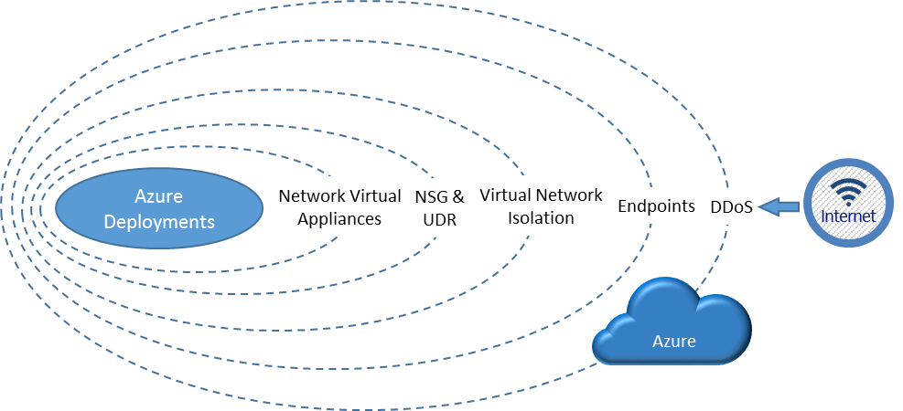
Security layers

Slide 51
NSG key facts
5-tuple ACL’s
Source IP, Destination IP, Source Port, Destination Port, Protocol (TCP, UDP, any)
Actions: allow or deny
Directions: inbound, outbound
Priority: 100-4096 (lower value = higher priority)
Stateful
No need to define rules for «return traffic»
Can be applied to NICs and Subnets (ARM)
Inbound connections: subnet-level NSG evaluated first, NIC-level NSG evaluated next
Outbound connections: NIC-level NSG evaluated first, subnet-level NSG evaluated next

Slide 52
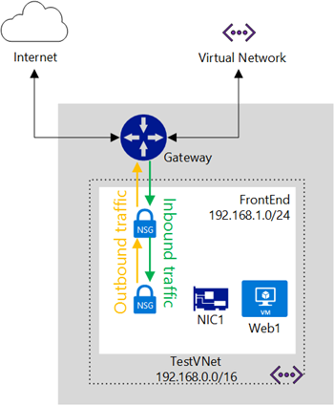
Subnet-level and NIC-level NSG

Slide 53
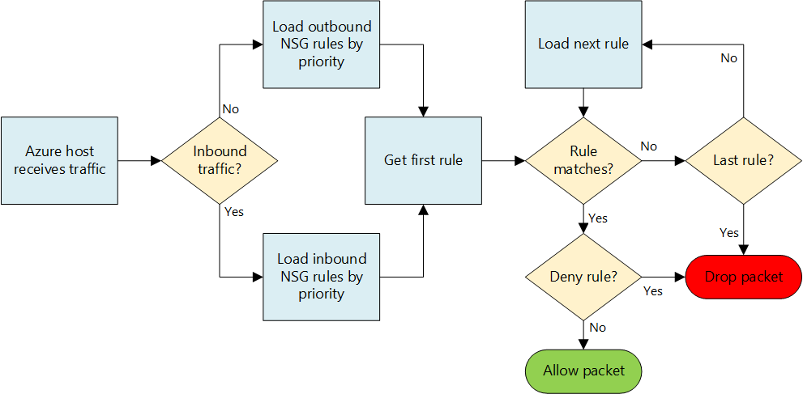
NSG evaluation

Slide 54
NSG rules
Default inbound rules
Allow any connections from other VMs in the same Vnet
Allow any connections from Azure Load Balancer (probes)
Deny all (minimum priority)
Default outbound rules
Allow any connections to other VMs in the same Vnet
Allow any connections to the public internet
Deny all (minimum priority)
Default tags
VIRTUAL_NETWORK, AZURE_LOADBALANCER, INTERNET

Slide 55
NSG limits (ARM)
See here for up-to-date information :
https://docs.microsoft.com/en-us/azure/azure-subscription-service-limits#networking-limits

Slide 56
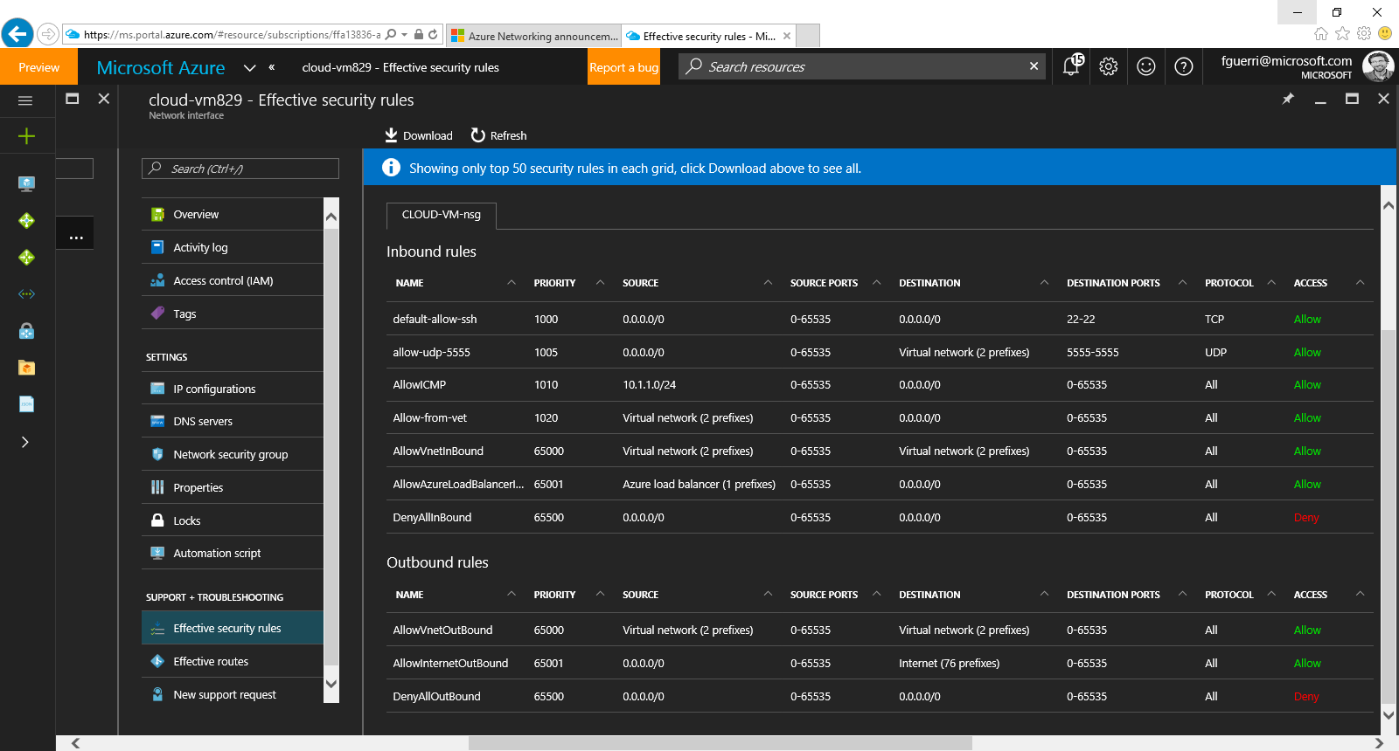
Troubleshooting NSGs

Slide 57
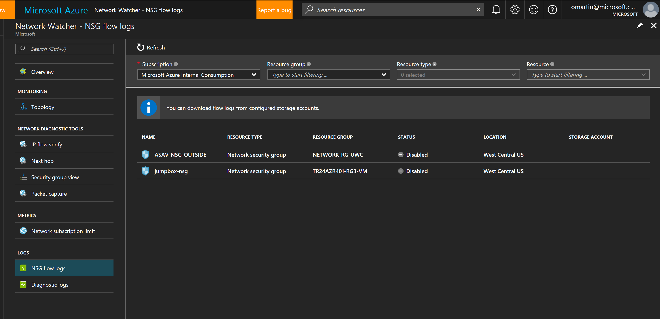
Troubleshooting NSGs (Network Watcher)

Slide 58
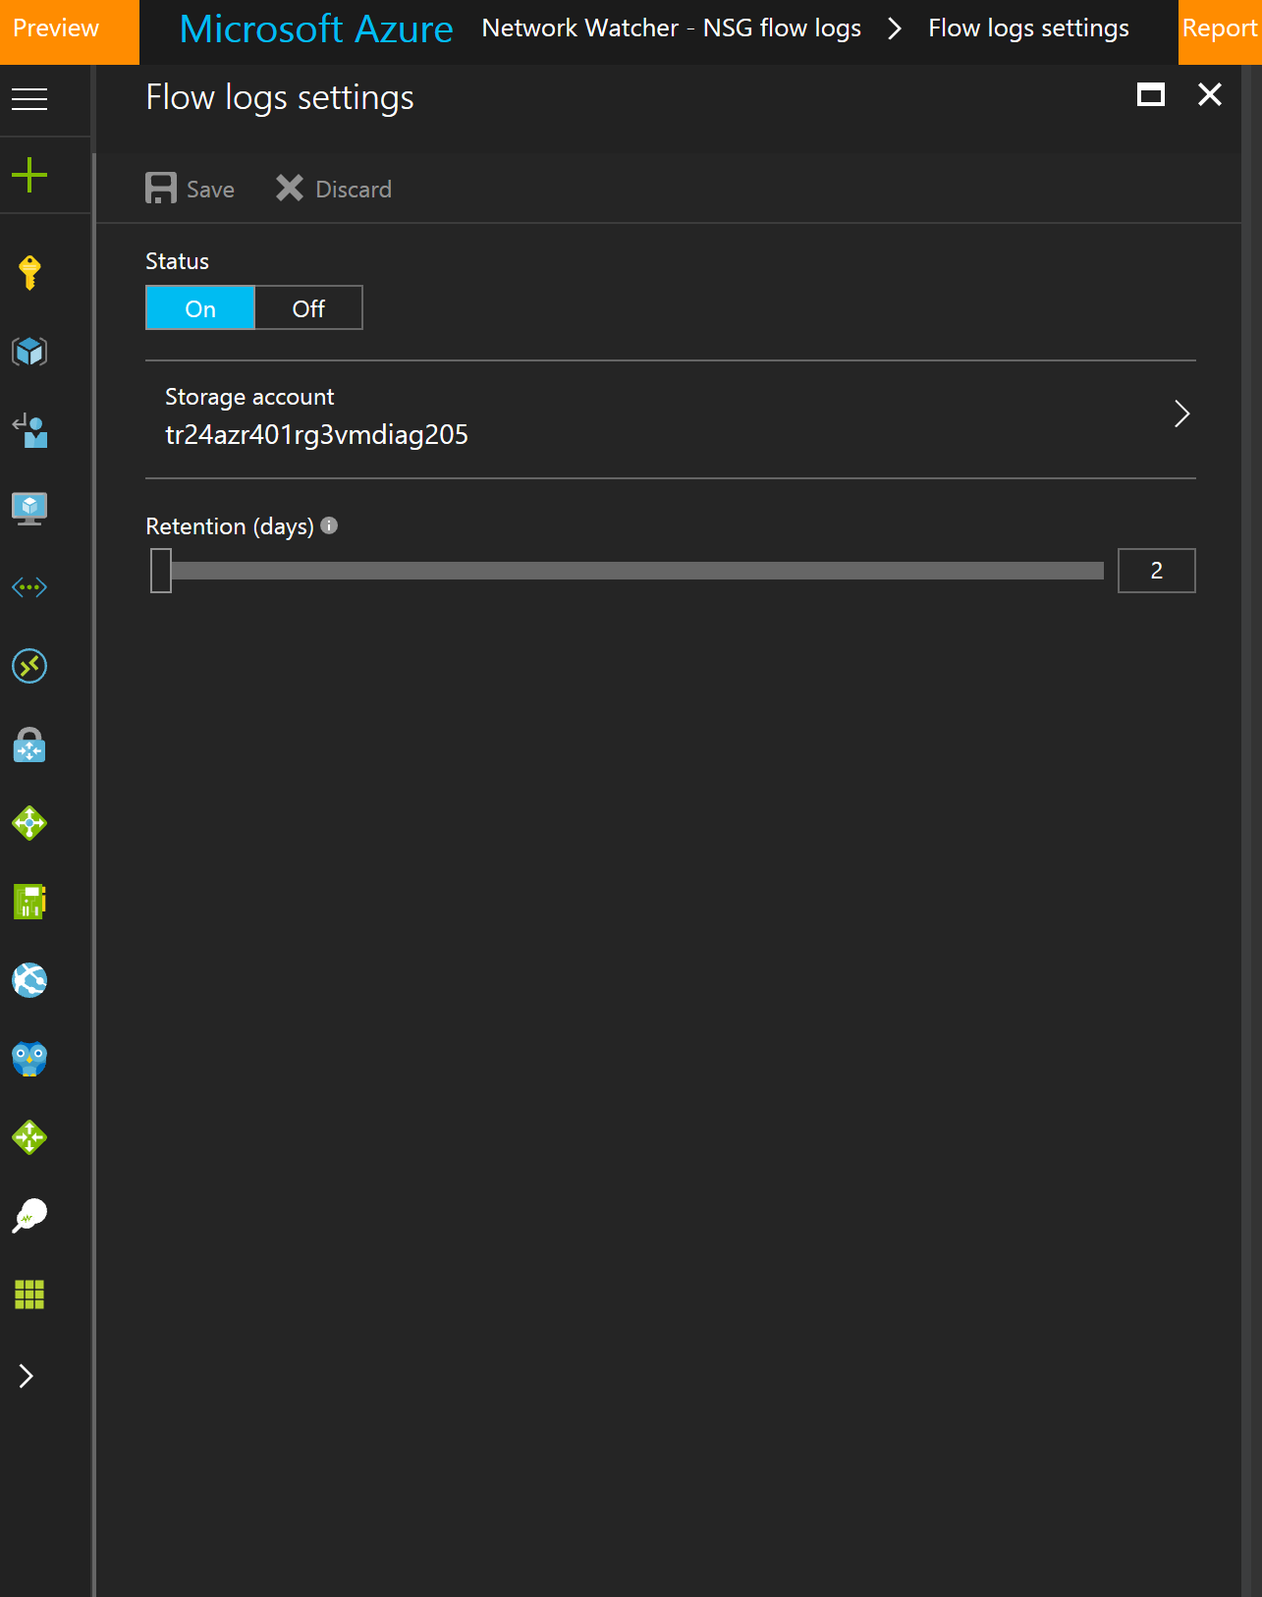
Troubleshooting NSGs (Network Watcher)

Slide 59
Cross-premises connectivity options

Slide 60
Virtual Network Gateway
Virtual layer-3 device that routes traffic to remote networks
Name: VNet1
Address space: 10.57.0.0/16
Virtual device attached to an Azure VNet (similar to VMs)
Always provisioned in a reserved subnet named «GatewaySubnet»
Highly available service
The «GatewaySubnet» is part of the VNet‘s address space (/27 or bigger)
Each Gateway is associated to a public IP address (via Azure Load Balancer)
Subnet1
10.57.1.0/24
Subnet2
10.57.2.0/25
GatewaySubnet
10.57.3.0/27
VM1
VM4
Virtual Network Gateway
VM3
VM5
VM2
VM6
Switch/router (Azure VM Switch)

Slide 61
Virtual Network Gateway
Gateway types: «VPN» or «ExpressRoute»
Name: VNet1
Address space: 10.57.0.0/16
VPN gateways: route traffic to remote networks over internet-based IPSec tunnels
ExpressRoute gateways: route traffic to on-prem networks over dedicated connectivity
Can coexist in the same VNet (if /27 or larger)
Subnet1
10.57.1.0/24
Subnet2
10.57.2.0/25
GatewaySubnet
10.57.3.0/27
VM1
VM4
ER
VM3
VM5
VM2
VM6
VPN
Switch/router (Azure VM Switch)

Slide 62
Site2site connectivity
Internet-based IPSec VPNs
Name: VNet1
Address space: 10.57.0.0/16
Subnet1
10.57.1.0/24
Subnet2
10.57.2.0/25
Gateway Subnet
10.57.3.0/27
IP = 4.5.6.7
On-Prem VPN Device
VM1
VM4
VPN GW
VM3
VM5
10.1.0.0/16
VM2
VM6
VPN GW’s public IP
40.112.124.15
Switch/router (Azure VM Switch)
Internet
Azure Load Balancer
IPSEC

Slide 63
Site2site connectivity
What is IPSec?
Encryption protocol whereby two networks can securely exchange traffic over public/unsecure networks
Supports different «modes»; in this scenario, «tunnel» mode is used, whereby traffic is encapsulated in an outer IP packet
Internet-based IPSec VPNs
Name: TRVNET1
Address space: 10.57.0.0/16
Subnet1
10.57.1.0/24
Subnet2
10.57.2.0/25
Gateway Subnet
10.57.3.0/27
IP = 4.5.6.7
On-Prem VPN Device
VM1
VM4
VPN GW
VM3
VM5
10.1.0.0/16
VM2
VM6
VPN GW’s public IP
40.112.124.15
Switch/router (Azure VM Switch)
Internet
Azure Load Balancer
IPSEC

Slide 64
Site2site connectivity
What is IPSec?
Encryption protocol whereby two networks can securely exchange traffic over public/insecure networks
Supports different «modes»; in this scenario, «tunnel» mode is used, whereby traffic is encapsulated in an outer IP packet
Internet-based IPSec VPNs
Source IP: 10.57.2.7
Dest IP:
10.1.5.5
Payload
Source IP: 40.112.124.15
Dest IP:
4.5.6.7
ESP
Source IP: 10.57.2.7
Dest IP:
10.1.5.5
Payload
Name: TRVNET1
Address space: 10.57.0.0/16
Name: TRVNET1
Address space: 10.57.0.0/16
Subnet1
10.57.1.0/24
Subnet2
10.57.2.0/25
Gateway Subnet
10.57.3.0/27
IP = 4.5.6.7
On-Prem VPN Device
VM1
VM4
VPN GW
VM3
VM5
10.57.2.7
10.1.0.0/16
VM2
VM6
VPN GW’s public IP
40.112.124.15
Switch/router (Azure VM Switch)
Internet
Azure Load Balancer
IPSEC

Slide 65
Site2site connectivity
What is IPSec?
Encryption protocol whereby two networks can securely exchange traffic over public/insecure networks
Supports different «modes»; in this scenario, «tunnel» mode is used, whereby traffic is encapsulated in an outer IP packet
Internet-based IPSec VPNs
Source IP: 10.57.2.7
Dest IP:
10.1.5.5
Payload
Source IP: 40.112.124.15
Dest IP:
4.5.6.7
ESP
Source IP: 10.57.2.7
Dest IP:
10.1.5.5
Payload
Name: TRVNET1
Address space: 10.57.0.0/16
Name: TRVNET1
Address space: 10.57.0.0/16
Encrypted
Subnet1
10.57.1.0/24
Subnet2
10.57.2.0/25
Gateway Subnet
10.57.3.0/27
IP = 4.5.6.7
On-Prem VPN Device
VM1
VM4
VPN GW
VM3
VM5
10.57.2.5
10.1.0.0/16
VM2
VM6
VPN GW’s public IP
40.112.124.15
Switch/router (Azure VM Switch)
Internet
Azure Load Balancer
IPSEC

Slide 66

ExpressRoute
Dedicated connectivity to on-prem networks
ER Provider’s network
10.1.0.0/16
Name: VNet1
Address space: 10.57.0.0/16
Subnet1
10.57.1.0/24
Subnet2
10.57.2.0/25
Gateway Subnet
10.57.3.0/27
VM1
VM4
VM3
VM5
Azure WAN
VM2
VM6
ER GW
TUNNEL
Switch/router
Azure Load Balancer
Internet

Slide 67
ExpressRoute
How is traffic handled over ER private peering?
IP packets are routed between VNets and on-prem networks over the MS network and a provider’s network
In order to ensure isolation among tenants (and allow them to use overlapping IP address ranges) traffic is in an IP tunnel while it crosses the Microsoft network
Dedicated connectivity to on-prem networks
ER Provider’s network
Source IP: 10.57.2.7
Dest IP:
10.1.5.5
Payload
10.1.0.0/16
Name: CR-VNET1
Address space: 10.57.0.0/16
Subnet1
10.57.1.0/24
Subnet2
10.57.2.0/25
Gateway Subnet
10.57.3.0/27
VM1
VM4
VM3
VM5
Azure WAN
VM2
VM6
ER GW
TUNNEL
Switch/router
Azure Load Balancer
Internet

Slide 68
ExpressRoute
How is traffic handled over ER private peering?
IP packets are routed between VNets and on-prem networks over the MS network and a provider’s network
In order to ensure isolation among tenants (and allow them to use overlapping IP address ranges) traffic is in an IP tunnel while it crosses the Microsoft network
Dedicated connectivity to on-prem networks
ER Provider’s network
Source IP: 10.57.2.7
Dest IP:
10.1.5.5
Payload
SRC IP
Dest IP
TUN
HDR
10.1.0.0/16
Source IP: 10.57.2.7
Dest IP:
10.1.5.5
Payload
Name: TRVNET1
Address space: 10.57.0.0/16
Name: TRVNET1
Address space: 10.57.0.0/16
Name: CR-VNET1
Address space: 10.57.0.0/16
Subnet1
10.57.1.0/24
Subnet2
10.57.2.0/25
Gateway Subnet
10.57.3.0/27
VM1
VM4
VM3
VM5
Azure WAN
VM2
VM6
ER GW
TUNNEL
Switch/router
Azure Load Balancer
Internet

Slide 69
ExpressRoute
How is traffic handled over ER private peering?
IP packets are routed between VNets and on-prem networks over the MS network and a provider’s network
In order to ensure isolation among tenants (and allow them to use overlapping IP address ranges) traffic is in an IP tunnel while it crosses the Microsoft network
Dedicated connectivity to on-prem networks
ER Provider’s network
Dest IP:
10.1.5.5
SRC IP
Source IP: 10.57.2.7
Dest IP:
10.1.5.5
10.1.0.0/16
Source IP: 10.57.2.7
Payload
Dest IP
TUN HDR
Source IP: 10.57.2.7
Dest IP:
10.1.5.5
Payload
Payload
Name: TRVNET1
Address space: 10.57.0.0/16
Name: TRVNET1
Address space: 10.57.0.0/16
Name: CR-VNET1
Address space: 10.57.0.0/16
Subnet1
10.57.1.0/24
Subnet2
10.57.2.0/25
Gateway Subnet
10.57.3.0/27
VM1
VM4
VM3
VM5
Azure WAN
VM2
VM6
ER GW
TUNNEL
Switch/router
Azure Load Balancer
Internet

Slide 70
Provisioning Virtual Network Gateways
Step #1. Select «gateway type»
Select «VPN» for IPSec VPNs, «ExpressRoute» for ER connections
Step#2. If type =VPN, select «VPN type»
Azure supports both «route-based» and «policy-based» VPNs
Step#3. Select gateway SKU
SKUs define maximum throughput and available features
Available SKUs for VPN : Basic, Standard, High-Perf
Available SKUs for ER : Standard, High-Perf and Ultra-Perf

Slide 71
Step #2. Select «VPN type»
Policy-based vs Route-based gateways
Different ways to implement IPSec VPNs in a network device
IPSec tunnels can be negotiated only between peers using the same VPN type
Azure supports both, but route-based gateways support more features
policy-based gateways do not support point-2-site connectivity
policy-based gateways support only 1 IPSec tunnel
policy based gateways do not support BGP

Slide 72
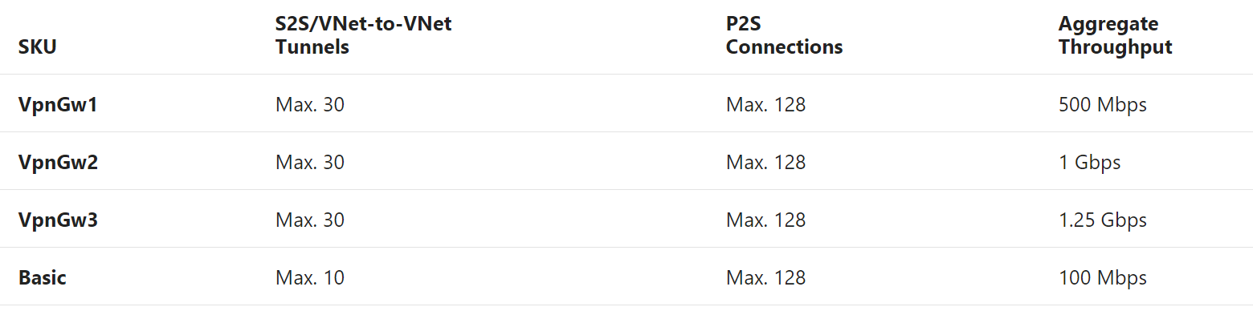
Step #3. Select gateway SKU
For VPN gateways
https://docs.microsoft.com/en-us/azure/vpn-gateway/vpn-gateway-about-vpngateways

Slide 73
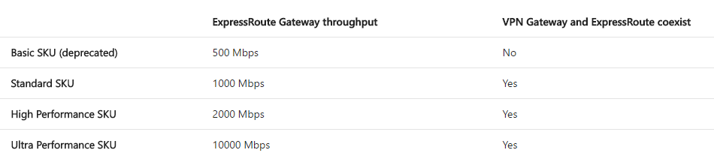
Step #3. Select gateway SKU
For ER gateways
https://docs.microsoft.com/en-us/azure/expressroute/expressroute-about-virtual-network-gateways

Slide 74
Configuring cross-premises connectivity

Slide 75
Configuring cross-premises connectivity (ARM)
Cross-premises connections require three things
A virtual network gateway
An object describing the «on-prem side»
A connection between the two
Connection
Virtual Network Gateway
On-Prem

Slide 76
Configuring cross-premises connectivity (ARM)
Connection
IPSec and ER connections share the same model
Virtual Network Gateway
Type = VPN
Local Network Gateway
IP range: 10.1.0.0/16
VPN peer: 1.2.3.4
Local Network Gateways describe an on-prem network
Connection
Virtual Network Gateway
Type = ExpressRoute
ExpressRoute circuit
- Circuit ID
Reference to a physical connection to an on-prem network

Slide 77
Configuring Site-2-Site connections (ARM)
IPSec tunnels to on-prem networks
Connection
Virtual Network Gateway
Type = VPN
On-Prem
(local network gateway)

Slide 78
Configuring Site-2-Site connections (ARM)
IPSec tunnels to on-prem networks
# Provision public IP address
$exampleIp = New-AzureRmPublicIpAddress -Name MYGWPUBIP -ResourceGroupName MYRG -AllocationMethod Dynamic -Location northeurope
# Get Gateway Subnet
$exampleSubnet = Get-AzureRmVirtualNetwork -Name MYVNET -ResourceGroupName MYRG | Get-AzureRmVirtualNetworkSubnetConfig -Name GatewaySubnet
# Define IP Configuration
$exampleGwIpConfig = New-AzureRmVirtualNetworkGatewayIpConfig -Name MYGWIPCONFIG -PublicIpAddressId $exampleIp.Id -SubnetId $exampleSubnet.Id
# Provision gateway
$exampleGw = New-AzureRmVirtualNetworkGateway -Name MYGW -ResourceGroupName MYRG -IpConfigurations $exampleGwIpConfig -GatewayType Vpn -VpnType RouteBased -GatewaySku Standard -Location northeurope
Connection
Virtual Network Gateway
Type = VPN
On-Prem
(local network gateway
OR
ExpressRoute circuit)

Slide 79
Configuring Site-2-Site connections (ARM)
IPSec tunnels to on-prem networks
$exampleLocalGW = New-AzureRmLocalNetworkGateway -Name LGW -ResourceGroupName MYRG -Location northeurope -GatewayIpAddress 1.2.3.4 -AddressPrefix 10.1.0.0/16
Connection
Virtual Network Gateway
Type = VPN
Local Network Gateway
IP range: 10.1.0.0/16
VPN peer: 1.2.3.4

Slide 80
Configuring Site-2-Site connections (ARM)
IPSec tunnels to on-prem networks
$exampleConn = New-AzureRmVirtualNetworkGatewayConnection -Name MYIPSECCONN -ResourceGroupName MYRG -Location northeurope -VirtualNetworkGateway1 $exampleGateway -LocalNetworkGateway2 $exampleLocalGW -ConnectionType IPsec
Connection
Virtual Network Gateway
Type = VPN
Local Network Gateway
IP range: 10.1.0.0/16
VPN peer: 1.2.3.4

Slide 81
Configuring ExpressRoute connections (ARM)
Dedicated connections to on-prem networks
Connection
Virtual Network Gateway
Type = ExpressRoute
ExpressRoute circuit

Slide 82
Configuring ExpressRoute connections (ARM)
# Provision public IP address
$exampleIp = New-AzureRmPublicIpAddress -Name MYGWPUBIP -ResourceGroupName MYRG -AllocationMethod Dynamic -Location northeurope
# Get Gateway Subnet
$exampleSubnet = Get-AzureRmVirtualNetwork -Name MYVNET -ResourceGroupName MYRG | Get-AzureRmVirtualNetworkSubnetConfig -Name GatewaySubnet
# Define IP Configuration
$exampleGwIpConfig = New-AzureRmVirtualNetworkGatewayIpConfig -Name MYGWIPCONFIG -PublicIpAddressId $exampleIp.Id -SubnetId $exampleSubnet.Id
# Provision gateway
$exampleERGw = New-AzureRmVirtualNetworkGateway -Name MYERGW -ResourceGroupName MYRG -IpConfigurations $exampleGwIpConfig -GatewayType ExpressRoute -GatewaySku Standard -Location northeurope
Dedicated connections to on-prem networks
Connection
Virtual Network Gateway
Type = ExpressRoute
ExpressRoute circuit

Slide 83
Configuring ExpressRoute connections (ARM)
# Get ER circuit
$circuit = Get-AzureRmExpressRouteCircuit -Name "MyCircuit" -ResourceGroupName "MYRG"
# Get ER gateway
$gw = Get-AzureRmVirtualNetworkGateway -Name “MYERGW" -ResourceGroupName "MYRG"
# Link VNet to ER circuit
$connection = New-AzureRmVirtualNetworkGatewayConnection -Name "ERConnection" -ResourceGroupName "MYRG" -Location northeurope -VirtualNetworkGateway1 $gw -PeerId $circuit.Id -ConnectionType ExpressRoute
Dedicated connections to on-prem networks
Connection
Virtual Network Gateway
Type = ExpressRoute
ExpressRoute circuit

Slide 84
Active-Active VPN gateways

Slide 85
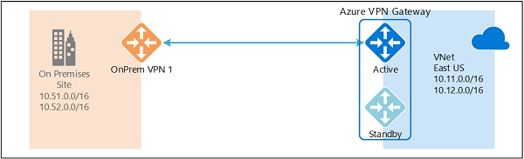
Azure VPN Gateway redundancy
https://docs.microsoft.com/en-us/azure/vpn-gateway/vpn-gateway-highlyavailable

Slide 86
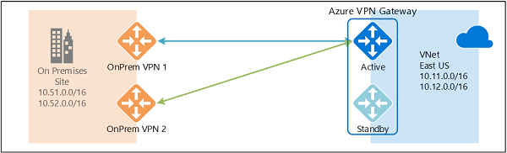
Redundant on-prem devices
https://docs.microsoft.com/en-us/azure/vpn-gateway/vpn-gateway-highlyavailable

Slide 87
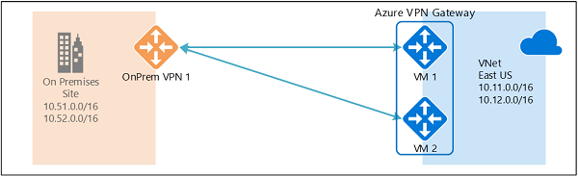
Active-active VPN gateway
https://docs.microsoft.com/en-us/azure/vpn-gateway/vpn-gateway-highlyavailable

Slide 88
Active-active VPN gateway
$vng = New-AzureRmVirtualNetworkGateway
-Name CLOUD-VPN-GW -ResourceGroupName IPSEC
-Location northeurope -IpConfigurations $gwipcfg1,$gwipcfg2
-GatewayType Vpn -VpnType RouteBased -GatewaySku HighPerformance
-EnableActiveActiveFeature -Asn 65003

Slide 89
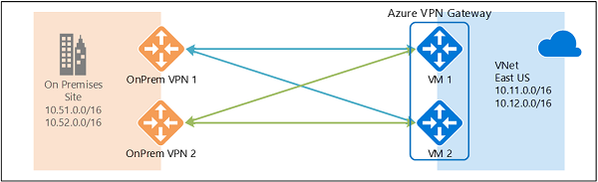
Active-active VPN gateway, redundant on-prem devices
https://docs.microsoft.com/en-us/azure/vpn-gateway/vpn-gateway-highlyavailable

Slide 90
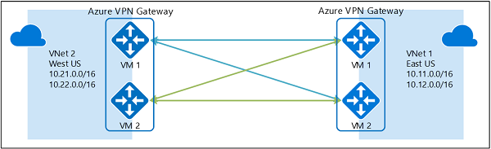
Vnet-2-Vnet with active-active VPN gateways
https://docs.microsoft.com/en-us/azure/vpn-gateway/vpn-gateway-highlyavailable

Slide 91
VPN Gateways Latest Announcements
https://azure.microsoft.com/en-us/roadmap/new-azure-vpn-gateways/

Slide 92
ExpressRoute Deep Dive

Slide 93
Dedicated connectivity
Internet
Customer Network
Microsoft Network
ExpressRoute
Customer Datacenter
Azure
Datacenter
Azure
Datacenter

Slide 94

ER peering locations
Internet
Customer Network
Microsoft Network
Customer Datacenter
Azure
Datacenter
Azure
Datacenter
ExpressRoute peering location

Slide 95
ER architecture
1.Connectivity to “meet-up” location
2. Aggregation partner’s exchange platform
3. Microsoft ER implementation
Customer Network
Microsoft Network
Customer Datacenter
Azure
Datacenter
Azure
Datacenter

Slide 96
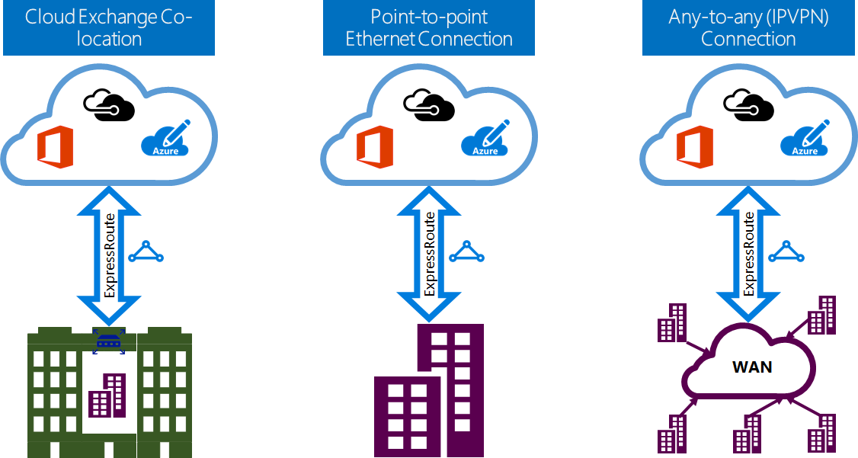
ER deployment models
ER partner hands off a LAYER 2 service to the end customer
ER partner hands off a LAYER 3 service to the end customer

Slide 97
How is this implemented in the three deployment models?
Customer Network
Microsoft Network
Customer Datacenter
Azure
Datacenter
Azure
Datacenter

Slide 98
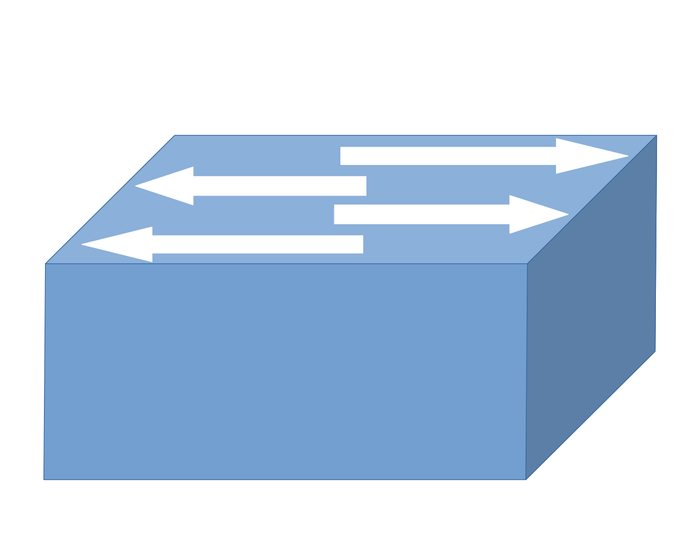
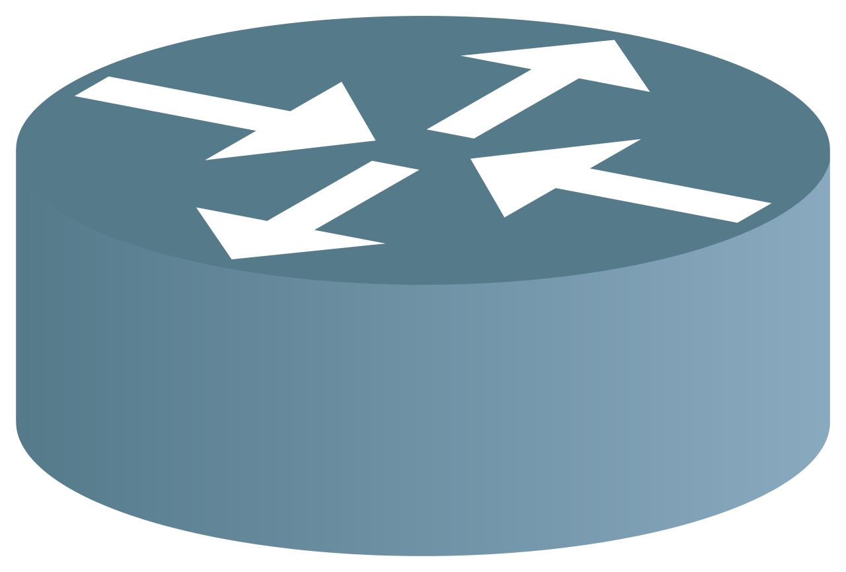
Cloud exchange colocation
Customer-owned routers
Aggregation partner’s exchange platform
Microsoft network infrastructure
Customer Network
Microsoft Network
Customer Datacenter
Azure
Datacenter
Azure
Datacenter
Layer 2 connection provided by non-ER carrier

Slide 99
Cloud exchange colocation Redundancy
Customer Network
Microsoft Network
Customer
Microsoft
Customer Datacenter
Azure
Datacenter
Azure
Datacenter

Slide 100
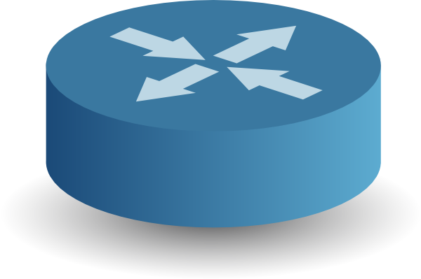
BGP Basics
BGP
Border Gateway Protocol
Protocol used by routers to agree which traffic they can exchange
BGP Session
A logical connection whereby two routers agree to exchange traffic to/from a set of IP addresses
BGP Session
I will deliver traffic to hosts in Network A
I will deliver traffic to hosts in Network B
Network A
Network B
Router “A”
Router “B”

Slide 101






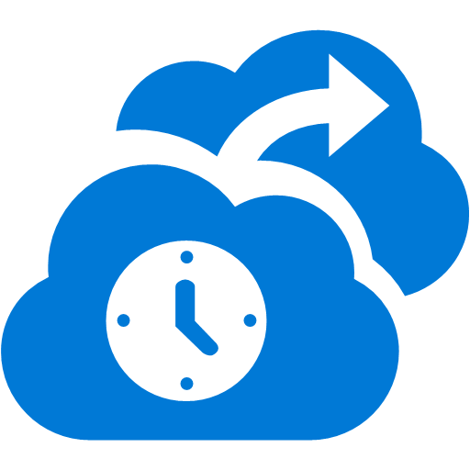











ExpressRoute and Microsoft Clouds
ER uses different BGP sessions for different cloud services
Partner Edge
Microsoft Edge
Customer’s network
Customer’s connection
“Microsoft” BGP Session: Traffic to Office 365 Services
“Azure Public” BGP Session: Traffic to public IP addresses in Azure
“Azure Private BGP Session”: Traffic to Virtual Networks

Slide 102
Cloud exchange colocation BGP Sessions
Customer Network
BGP
Microsoft Network
Customer
Microsoft
BGP
Customer Datacenter
Azure
Datacenter
Azure
Datacenter
Customer establishes BGP sessions
Customer is responsible for addressing routing and NAT requirements

Slide 103
Cloud exchange colocation Implementation responsibilities
Customer Network
BGP
Microsoft Network
Customer
Microsoft
BGP
Customer Datacenter
Azure
Datacenter
Azure
Datacenter
Implemented by the customer (works with carrier of choice)
Implemented by the ER provider (aggregation partner)
Implemented by Microsoft

Slide 104

Cloud exchange colocation Cost structure
Customer Network
1 Invoice
BGP
1 Invoice
Azure Consumed Service
1 Invoice
Microsoft Network
Customer
Microsoft
BGP
Customer Datacenter
Azure
Datacenter
Azure
Datacenter
Implemented by the customer (works with carrier of choice)
Implemented by the ER provider (aggregation partner)
Implemented by Microsoft

Slide 105
Point-to-Point Ethernet connection
Customer-owned routers
Aggregation partner’s exchange platform
Microsoft network infrastructure
Customer Network
Microsoft Network
Customer
Microsoft
Customer Datacenter
Azure
Datacenter
Azure
Datacenter
Routers and connectivity provided by the ER partner

Slide 106
Point-to-Point Ethernet connection BGP Sessions
Customer Network
BGP
Microsoft Network
BGP
Customer Datacenter
Azure
Datacenter
Azure
Datacenter
Customer establishes BGP sessions
Customer is responsible for addressing routing and NAT requirements

Slide 107
Point-to-Point Ethernet connection Implementation responsibilities
Customer Network
BGP
Microsoft Network
BGP
Customer Datacenter
Azure
Datacenter
Azure
Datacenter
Implemented by the customer
Implemented by the ER provider (resells access to aggregation partner’s exchange platform)
Implemented by Microsoft

Slide 108



Point-to-Point Ethernet connection Cost structure
1 Invoice
1 Invoice
Azure Consumed Service
Customer Network
BGP
Microsoft Network
Customer
Microsoft
BGP
Customer Datacenter
Azure
Datacenter
Azure
Datacenter
Implemented by the customer
Implemented by the ER provider (resells access to aggregation partner’s exchange platform)
Implemented by Microsoft

Slide 109
IP VPN Connection
Customer site
Customer site
MPLS backbone
Customer site
Microsoft Network
Microsoft
Customer site
Azure
Datacenter
Azure
Datacenter
Customer site

Slide 110
IP VPN Connection
Customer site
Customer site
MPLS backbone
Customer site
Microsoft Network
Customer site
Azure
Datacenter
Azure
Datacenter
Customer site

Slide 111
IP VPN Connection – BGP Sessions
ER provider establishes BGP sessions
ER provider is responsible for addressing routing and NAT requirements
Customer site
Customer site
MPLS backbone
Customer site
BGP
BGP
Microsoft Network
BGP
Customer site
BGP
Azure
Datacenter
Azure
Datacenter
Customer site

Slide 112
IP VPN Connection Implementation responsibilities
Customer site
Implemented by Microsoft
Customer site
MPLS backbone
Customer site
BGP
BGP
Microsoft Network
Microsoft
BGP
Customer site
BGP
Azure
Datacenter
Azure
Datacenter
Customer site
Implemented by the ER provider (resells access to aggregation partner’s exchange platform)

Slide 113






IP VPN Connection – Cost structure
Customer site
Implemented by Microsoft
Customer site
1 Invoice
MPLS backbone
Customer site
BGP
1 Invoice
Azure Consumed Service
BGP
Microsoft Network
Microsoft
BGP
Customer site
BGP
Azure
Datacenter
Azure
Datacenter
Customer site
Implemented by the ER provider (resells access to aggregation partner’s exchange platform)

Slide 114
Connecting VNets

Slide 115
Connecting VNets - Options
IPSec tunnels (aka VNet-2-VNet)
Cross-region
Requires gateway, which limits throughput
VNet peering
Intra-region only
No gateway devices/high throughput

Slide 116
Virtual Network to Virtual Network connectivity

Slide 117
VNet-2-VNet connectivity
VNets can be connected with each other via IPSec tunnels
Name: VNet3
Address space: 10.57.0.0/16
Name: VNet4
Address space: 10.6.0.0/16
Subnet1
10.57.1.0/24
Gateway Subnet
10.57.3.0/27
Gateway Subnet
10.6.3.0/27
Subnet1
10.6.11.0/24
VM1
VM3
VM1
VM3
VPN
VNet-2-VNet
VPN
VM2
VM2

Slide 118
VNet-2-VNet connectivity
How a VNet-2-VNet connection is reflected in the route table
Name: VNet3
Address space: 10.57.0.0/16
Name: VNet4
Address space: 10.6.0.0/16
Subnet1
10.57.1.0/24
Gateway Subnet
10.57.3.0/27
Gateway Subnet
10.6.3.0/27
Subnet1
10.6.11.0/24
VM1
VM3
VM1
VM3
VPN
VPN
VM2
VM2
System Route Table: TRVNET3
Dest: 10.57.0.0/16 | Send to: Local VNet
Dest: 0.0.0.0/0 | Send to: Internet
System Route Table: TRVNET4
Dest: 10.6.0.0/16 | Send to: Local VNet
Dest: 0.0.0.0/0 | Send to: Internet

Slide 119
VNet-2-VNet connectivity
How a VNet-2-VNet connection is reflected in the route table
Name: VNet3
Address space: 10.57.0.0/16
Name: VNet4
Address space: 10.6.0.0/16
Subnet1
10.57.1.0/24
Gateway Subnet
10.57.3.0/27
Gateway Subnet
10.6.3.0/27
Subnet1
10.6.11.0/24
VM1
VM3
VM1
VM3
VPN
VNet-2-VNet
VPN
VM2
VM2
System Route Table: TRVNET3
Dest: 10.57.0.0/16 | Send to: Local VNet
Dest: 0.0.0.0/0 | Send to: Internet
System Route Table: TRVNET4
Dest: 10.6.0.0/16 | Send to: Local VNet
Dest: 10.57.0.0/16 | Send to: VNet Gateway
Dest: 0.0.0.0/0 | Send to: Internet

Slide 120
VNet-2-VNet connectivity
How a VNet-2-VNet connection is reflected in the route table
Name: VNet3
Address space: 10.57.0.0/16
Name: VNet4
Address space: 10.6.0.0/16
Subnet1
10.57.1.0/24
Gateway Subnet
10.57.3.0/27
Gateway Subnet
10.6.3.0/27
Subnet1
10.6.11.0/24
VM1
VM3
VM1
VM3
VPN
VNet-2-VNet
VPN
VM2
VM2
System Route Table: TRVNET3
Dest: 10.57.0.0/16 | Send to: Local VNet
Dest: 10.6.0.0/16 | Send to: VNet Gateway
Dest: 0.0.0.0/0 | Send to: Internet
System Route Table: TRVNET4
Dest: 10.6.0.0/16 | Send to: Local VNet
Dest: 10.57.0.0/16 | Send to: VNet Gateway
Dest: 0.0.0.0/0 | Send to: Internet

Slide 121
VNet-2-VNet connectivity
Multiple VNets can be connected
Name: VNet4
Address space: 10.6.0.0/16
System Route Table: TRVNET4
Dest: 10.6.0.0/16 | Send to: Local VNet
Dest: 0.0.0.0/0 | Send to: Internet
Gateway Subnet
10.6.3.0/27
Subnet1
10.6.11.0/24
Name: VNet3
Address space: 10.57.0.0/16
VM1
VM3
System Route Table: TRVNET3
Dest: 10.57.0.0/16 | Send to: Local VNet
Dest: 0.0.0.0/0 | Send to: Internet
VPN
VM2
Subnet1
10.57.1.0/24
Gateway Subnet
10.57.3.0/27
VM1
VM3
VPN
Name: VNet5
Address space: 10.7.0.0/16
VM2
System Route Table: TRVNET5
Dest: 10.7.0.0/16 | Send to: Local VNet
Dest: 0.0.0.0/0 | Send to: Internet
Gateway Subnet
10.7.3.0/27
Subnet1
10.7.8.0/24
VM1
VM3
VPN
VM2

Slide 122
VNet-2-VNet connectivity
Routing with multiple VNet-2-VNet connections
Name: VNet4
Address space: 10.6.0.0/16
System Route Table: TRVNET4
Dest: 10.6.0.0/16 | Send to: Local VNet
Dest: 10.57.0.0/16 | Send to: VNet GW
Dest: 0.0.0.0/0 | Send to: Internet
Gateway Subnet
10.6.3.0/27
Subnet1
10.6.11.0/24
Name: VNet3
Address space: 10.57.0.0/16
VM1
VM3
System Route Table: TRVNET3
Dest: 10.57.0.0/16 | Send to: Local VNet
Dest: 10.6.0.0/16 | Send to: VNet GW
Dest: 0.0.0.0/0 | Send to: Internet
VPN
VM2
Subnet1
10.57.1.0/24
Gateway Subnet
10.57.3.0/27
VNet-2-VNet
VM1
VM3
VPN
Name: VNet5
Address space: 10.7.0.0/16
VM2
System Route Table: TRVNET5
Dest: 10.7.0.0/16 | Send to: Local VNet
Dest: 0.0.0.0/0 | Send to: Internet
Gateway Subnet
10.7.3.0/27
Subnet1
10.7.8.0/24
VM1
VM3
VPN
VM2

Slide 123
VNet-2-VNet connectivity
Routing with multiple VNet-2-VNet connections
Name: VNet4
Address space: 10.6.0.0/16
System Route Table: TRVNET4
Dest: 10.6.0.0/16 | Send to: Local VNet
Dest: 10.57.0.0/16 | Send to: VNet GW
Dest: 0.0.0.0/0 | Send to: Internet
Gateway Subnet
10.6.3.0/27
Subnet1
10.6.11.0/24
Name: VNet3
Address space: 10.57.0.0/16
VM1
VM3
System Route Table: TRVNET3
Dest: 10.57.0.0/16 | Send to: Local VNet
Dest: 10.6.0.0/16 | Send to: VNet GW
Dest: 10.7.0.0/16 | Send to: VNet GW
Dest: 0.0.0.0/0 | Send to: Internet
VPN
VM2
Subnet1
10.57.1.0/24
Gateway Subnet
10.57.3.0/27
VNet-2-VNet
VM1
VM3
VPN
Name: VNet5
Address space: 10.7.0.0/16
VM2
System Route Table: TRVNET5
Dest: 10.7.0.0/16 | Send to: Local VNet
Dest: 10.57.0.0/16 | Send to: VNet GW
Dest: 0.0.0.0/0 | Send to: Internet
VNet-2-VNet
Gateway Subnet
10.7.3.0/27
Subnet1
10.7.8.0/24
VM1
VM3
VPN
VM2

Slide 124
VNet-2-VNet connectivity
Routing with multiple VNet-2-VNet connections
Name: VNet4
Address space: 10.6.0.0/16
System Route Table: TRVNET4
Dest: 10.6.0.0/16 | Send to: Local VNet
Dest: 10.57.0.0/16 | Send to: VNet GW
Dest: 0.0.0.0/0 | Send to: Internet
Gateway Subnet
10.6.3.0/27
Subnet1
10.6.11.0/24
Name: VNet3
Address space: 10.57.0.0/16
VM1
VM3
System Route Table: TRVNET3
Dest: 10.57.0.0/16 | Send to: Local VNet
Dest: 10.6.0.0/16 | Send to: VNet GW
Dest: 10.7.0.0/16 | Send to: VNet GW
Dest: 0.0.0.0/0 | Send to: Internet
VPN
VM2
Subnet1
10.57.1.0/24
Gateway Subnet
10.57.3.0/27
VNet-2-VNet
VM1
VM3
VPN
Name: VNet5
Address space: 10.7.0.0/16
VM2
System Route Table: TRVNET5
Dest: 10.7.0.0/16 | Send to: Local VNet
Dest: 10.57.0.0/16 | Send to: VNet GW
Dest: 0.0.0.0/0 | Send to: Internet
VNet-2-VNet
Gateway Subnet
10.7.3.0/27
Subnet1
10.7.8.0/24
No transit routing: TRVNET4 and TRVNET5 do not have routes in their tables to send traffic to each other!!
VM1
VM3
VPN
VM2

Slide 125
VNet-2-VNet connectivity
How to achieve any-to-any connectivity?
Name: VNet4
Address space: 10.6.0.0/16
Gateway Subnet
10.6.3.0/27
Subnet1
10.6.11.0/24
Name: VNet3
Address space: 10.57.0.0/16
VM1
VM3
VPN
VM2
Subnet1
10.57.1.0/24
Gateway Subnet
10.57.3.0/27
VNet-2-VNet
VM1
VM3
VPN
Name: VNet5
Address space: 10.7.0.0/16
VM2
VNet-2-VNet
Gateway Subnet
10.7.3.0/27
Subnet1
10.7.8.0/24
VM1
VM3
VPN
VM2

Slide 126
VNet-2-VNet connectivity
How to achieve any-to-any connectivity?
Name: VNet4
Address space: 10.6.0.0/16
Gateway Subnet
10.6.3.0/27
Subnet1
10.6.11.0/24
Name: VNet3
Address space: 10.57.0.0/16
VM1
VM3
VPN
VM2
Subnet1
10.57.1.0/24
Gateway Subnet
10.57.3.0/27
VNet-2-VNet
Option #1: full mesh topology (each VNet is directly connected to any other VNet)
VM1
VM3
VNet-2-VNet
VPN
Name: VNet5
Address space: 10.7.0.0/16
VM2
VNet-2-VNet
Gateway Subnet
10.7.3.0/27
Subnet1
10.7.8.0/24
VM1
VM3
VPN
VM2

Slide 127
VNet-2-VNet connectivity
How to achieve any-to-any connectivity?
Name: VNet4
Address space: 10.6.0.0/16
Gateway Subnet
10.6.3.0/27
Subnet1
10.6.11.0/24
Name: VNet3
Address space: 10.57.0.0/16
VM1
VM3
VPN
BGP
VM2
Subnet1
10.57.1.0/24
Gateway Subnet
10.57.3.0/27
VNet-2-VNet
Option #2: leverage BGP support
VM1
VM3
VPN
Name: VNet5
Address space: 10.7.0.0/16
VM2
BGP
VNet-2-VNet
Gateway Subnet
10.7.3.0/27
Subnet1
10.7.8.0/24
VM1
VM3
VPN
BGP
VM2

Slide 128
VNet-2-VNet connectivity
How to achieve any-to-any connectivity?
Name: VNet4
Address space: 10.6.0.0/16
Gateway Subnet
10.6.3.0/27
Subnet1
10.6.11.0/24
Name: VNet3
Address space: 10.57.0.0/16
VM1
VM3
VPN
BGP
VM2
Subnet1
10.57.1.0/24
Gateway Subnet
10.57.3.0/27
VNet-2-VNet
VM1
VM3
VPN
Name: VNet5
Address space: 10.7.0.0/16
VM2
BGP
VNet-2-VNet
Gateway Subnet
10.7.3.0/27
Subnet1
10.7.8.0/24
VM1
VM3
VPN
BGP
VM2
Please send me packets going to:
10.7.0.0/16

Slide 129

VNet-2-VNet connectivity
How to achieve any-to-any connectivity?
Name: VNet4
Address space: 10.6.0.0/16
Gateway Subnet
10.6.3.0/27
Subnet1
10.6.11.0/24
Name: VNet3
Address space: 10.57.0.0/16
VM1
VM3
VPN
BGP
VM2
Subnet1
10.57.1.0/24
Gateway Subnet
10.57.3.0/27
VNet-2-VNet
VM1
VM3
VPN
Name: VNet5
Address space: 10.7.0.0/16
VM2
BGP
VNet-2-VNet
Gateway Subnet
10.7.3.0/27
Subnet1
10.7.8.0/24
OK
VM1
VPN
VM3
BGP
VM2
Please send me packets going to:
10.7.0.0/16

Slide 130
VNet-2-VNet connectivity
How to achieve any-to-any connectivity?
Name: VNet4
Address space: 10.6.0.0/16
Gateway Subnet
10.6.3.0/27
Subnet1
10.6.11.0/24
Name: VNet3
Address space: 10.57.0.0/16
VM1
VM3
VPN
BGP
VM2
Subnet1
10.57.1.0/24
Gateway Subnet
10.57.3.0/27
VNet-2-VNet
VM1
VM3
VPN
Name: VNet5
Address space: 10.7.0.0/16
VM2
BGP
VNet-2-VNet
Gateway Subnet
10.7.3.0/27
Subnet1
10.7.8.0/24
Please send me packets going to:
10.7.0.0/16 and
10.57.0.0/16
OK
VM1
VPN
VM3
BGP
VM2
Please send me packets going to:
10.7.0.0/16

Slide 131
VNet-2-VNet connectivity
How to achieve any-to-any connectivity?
Name: VNet4
Address space: 10.6.0.0/16
System Route Table: TRVNET4
Dest: 10.6.0.0/16 | Send to: Local VNet
Dest: 10.57.0.0/16 | Send to: VNet GW
Dest: 10.7.0.0/16 | Send to VNet GW
Dest: 0.0.0.0/0 | Send to: Internet
OK
Gateway Subnet
10.6.3.0/27
Subnet1
10.6.11.0/24
Name: VNet3
Address space: 10.57.0.0/16
VM1
VM3
VPN
BGP
VM2
Subnet1
10.57.1.0/24
Gateway Subnet
10.57.3.0/27
VNet-2-VNet
VM1
VM3
VPN
Name: VNet5
Address space: 10.7.0.0/16
TRVNET4 has now a route to send traffic to TRVNET5. TRVNET3 acts as a tranist network
VM2
BGP
VNet-2-VNet
Gateway Subnet
10.7.3.0/27
Subnet1
10.7.8.0/24
Please send me packets going to:
10.7.0.0/16 and
10.57.0.0/16
OK
VM1
VPN
VM3
BGP
VM2
Please send me packets going to:
10.7.0.0/16

Slide 132
Configuring VNet-2-VNet connectivty
VNet-2-VNet connections require four things
A virtual network gateway for VNet1
A virtual network gateway for VNet2
A connection from VNet1 to VNet2
A connection from VNet2 to VNet1
Connection objects have a «direction»
Connection 1→2
GW1
(VNET1’s
VPN gateway)
Connection 1 → 2
GW2
(VNET2’s
VPN gateway)
Connection 2 → 1

Slide 133
Configuring VNet-2-VNet connectivty
# Get first peer
$GW1 = Get-AzureRmVirtualNetworkGateway -Name GW1 -ResourceGroupName MYRG
# Get second peer$GW2 = Get-AzureRmVirtualNetworkGateway -Name GW2 -ResourceGroupName MYRG
# Create VNet-to-Vnet connection GW1 --> GW2
$exampleConn = New-AzureRmVirtualNetworkGatewayConnection -Name MYCONN1TO2 -ResourceGroupName MYRG -Location northeurope -VirtualNetworkGateway1 $GW1 -VirtualNetworkGateway2 $GW2 -ConnectionType Vnet2Vnet -SharedKey ABCDEFG123
# Create VNet-to-Vnet connection GW2 --> GW1
$exampleConn = New-AzureRmVirtualNetworkGatewayConnection -Name MYCONN2TO1 -ResourceGroupName MYRG -Location northeurope -VirtualNetworkGateway1 $GW2 -VirtualNetworkGateway2 $GW1 -ConnectionType Vnet2Vnet -SharedKey ABCDEFG123
VNet-2-VNet connections require four things
A virtual network gateway for VNet1
A virtual network gateway for VNet2
A connection from VNet1 to VNet2
A connection from VNet2 to VNet1
Connection 1→2
GW1
(VNET1’s
VPN gateway)
Connection 1 → 2
GW2
(VNET2’s
VPN gateway)
Connection 2 → 1

Slide 134
VNet-2-VNet connectivity
How to achieve any-to-any connectivity?
Option#1: Full Mesh | Option#2: BGP + transit routing
Efficient routing: each VNet is directly connected to any other VNet | Traffic between VNets may cross 1 or more transit networks
Many VNet-2-VNet connections to be maintained | Any-to-any connectivity is possible with fewer VNET-2VNET connections
Cross-VNET communication performance is capped by VNet Gateway’s bandwidth | Cross-VNET communication performance is capped by VNet Gateway’s bandwidth

Slide 135

VNet-2-VNet connectivity
How to achieve any-to-any connectivity?
Option#1: Full Mesh | Option#2: BGP + transit routing
Efficient routing: each VNet is directly connected to any other VNet | Traffic between VNets may cross 1 or more transit networks
Many VNet-2-VNet connections to be maintained | Any-to-any connectivity is possible with fewer VNET-2VNET connections
Cross-VNET communication performance is capped by VNet Gateway’s bandwidth | Cross-VNET communication performance is capped by VNet Gateway’s bandwidth
Both options limitations: VNet peering addresses them by pushing the complexity of connecting VNet into Azure’s network stack!

Slide 136
Virtual Network Peering

Slide 137
What is VNet peering?
Ability to “merge” two Azure VNets, so that VMs in the two VNets can communicate with each other as if they were on the same VNet
VNet1
VNet2
Subnet1
Subnet2
Subnet1
Subnet2
VM1
VM3
VM4
VM1
VM3
VM4
VM5
VM5
VM2
VM6
VM2
VM6
Switch/Routing
Switch/Routing

Slide 138
What is VNet peering?
Ability to “merge” two Azure VNets, so that VMs in the two VNets can communicate with each other as if they were on the same VNet
VNet1
VNet2
Subnet1
Subnet2
Subnet1
Subnet2
VM1
VM3
VM4
VM1
VM3
VM4
VM5
VM5
VM2
VM6
VM2
VM6
Switch/Routing

Slide 139
VNet peering key facts
Traffic across peering VNets is managed in a very similar way to intra-VNet traffic
Works only for VNets in the same region
Provides the same performance as intra-VNet traffic
Works across subscriptions (if subscriptions are under the same Azure AD Tenant)
At least one of the two VNets must be ARM

Slide 140
VNet peering transit routing is configurable
VNet1
VNet2
VNet3
Peering
Peering
VNet1 can send/receive traffic to/from VNet2
VNet2 can send/receive traffic to/from VNet1, VNet3
VNet3 can send/receive traffic to/from VNet2
VNet1 can talk to VNet3 only if it
It knows its routes (over UDRs)
The peerings are configured to allow transitive routing

Slide 141
VNet peering: Hub & Spoke
HR VNet
Peering
All VNets can communicate with the Hub Vnet
HR, Marketing and Engineering can “talk” to each other only if “Allowed Forwarded Traffic” is set
Marketing VNet
Hub site
(shared services)
Peering
Peering
Engineering
VNet

Slide 142
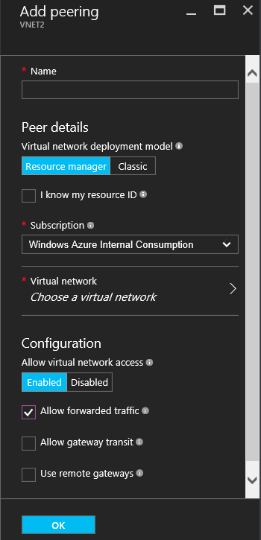
Transit routing
Can be allowed/denied

Slide 143
Gateway transit
A VNet’s ability to route traffic which has not been originated in it and is not destined to it
VNet1
VNet2
Peering
Virtual Network Gateway
IPSec or ER
On-Prem
VM A

Slide 144
Gateway transit
A VNet’s ability to route traffic which has not been originated in it and is not destined to it
VNet1
VNet2
Peering
Virtual Network Gateway
IPSec or ER
On-Prem
VM A
VNet1 and VNet2 must be both ARM!
There has to be a VNG in Vnet2!

Slide 145
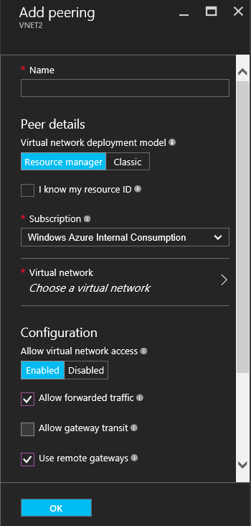
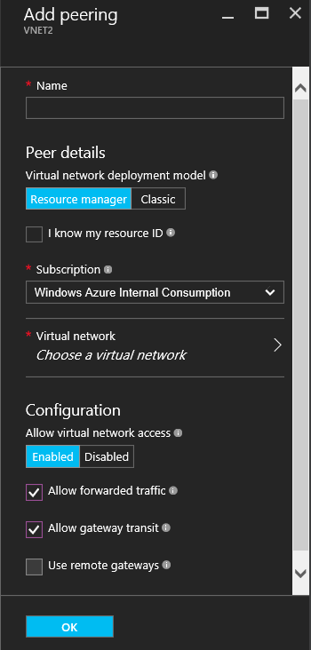
Gateway transit
Must be explicitly enabled in both peers
Setting for VNet1 (spoke)
Setting for VNet2
(hub)

Slide 146
Peering and NSG’s
A VNet can include its peers’ address spaces in its VIRTUAL_NETWORK tag
VNet1
10.57.1.0/24
VNet2
192.168.1.0/24
VIRTUAL_NETWORK =
10.57.1.0/24
168.63.129.16/32
VIRTUAL_NETWORK =
192.168.1.0/24
168.63.129.16/32

Slide 147
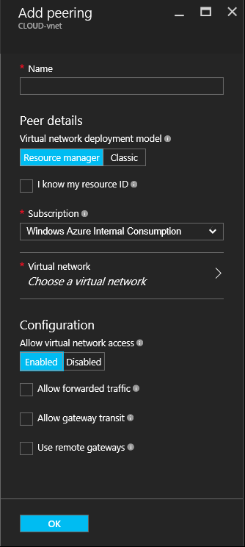
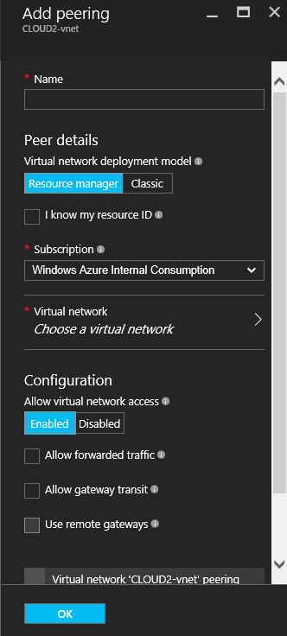
Peering and NSG’s
A VNet can include its peers’ address spaces in its VIRTUAL_NETWORK tag
VNet1
10.57.1.0/24
VNet2
192.168.1.0/24
Peering
VIRTUAL_NETWORK =
10.57.1.0/24
168.63.129.16/32
192.168.1.0/24
VIRTUAL_NETWORK =
192.168.1.0/24
168.63.129.16/32
10.57.1.0/24

Slide 148
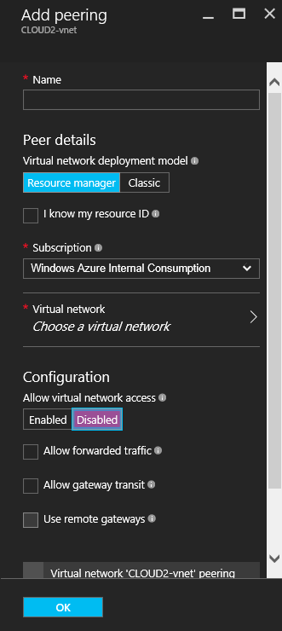
Peering and NSG’s
A VNet can include its peers’ address spaces in its VIRTUAL_NETWORK tag
VNet1
10.57.1.0/24
VNet2
192.168.1.0/24
Peering
VIRTUAL_NETWORK =
10.57.1.0/24
168.63.129.16/32
192.168.1.0/24
VIRTUAL_NETWORK =
192.168.1.0/24
168.63.129.16/32

Slide 149
Routing in Azure Virtual Networks

Slide 150
Route Table
Set of rules that define the «next hop» for IP packets based on their destination IP
Route Table (Simplified)
Dest: 10.57.0.0/16 | On-link
Dest: 10.3.2.0/24 | On-link
Dest: 10.100.0.0/16 | Next hop: <gateway IP>
Dest: 192.168.0.0/16 | Next hop: <gateway IP>
Dest: 0.0.0.0/0 | Next hop: <default gateway IP>
Destinations that can be reached directly without crossing layer-3 devices
Destinations that can be reached through a known layer-3 gateway device
Gateway for any other destination

Slide 151
VNet System Route Table
The default routing behavior for an Azure VNet is defined by the «System Route Table»
System Route Table
Local VNet rules
Packets with destination IP address included in VNet's address space → send directly to destination VM
Cross-prem rules
Packets with destination IP address belonging to networks connected via ER or IPSec → send to ER/S2S Virtual Network Gateway
Internet rule
Packets that do not match previous rules → send to the internet

Slide 152
System Route Table
Example
Customer network
10.100.0.0/16
192.168.0.0/16
Name: VNet2
Address space: 10.57.0.0/16, 10.3.2.0/24
Subnet1
10.57.1.0/24
Subnet2
10.3.2.0/24
Gateway Subnet
10.57.3.0/27
ExpressRoute
VM1
VM4
VM3
VM5
ER GW
VM2
VM6

Slide 153
System Route Table
Example
Customer network
10.100.0.0/16
192.168.0.0/16
Name: VNet2
Address space: 10.57.0.0/16, 10.3.2.0/24
Subnet1
10.57.1.0/24
Subnet2
10.3.2.0/24
Gateway Subnet
10.57.3.0/27
VM4
ExpressRoute
VM1
VM3
VM5
ER GW
VM2
VM6
System Route Table
Dest: 10.57.0.0/16 | Send to: Local VNet
Dest: 10.3.2.0/24 | Send to: Local VNet
Dest: 10.100.0.0/16 | Send to: ER Gateway
Dest: 192.168.0.0/16 | Send to: ER Gateway
Dest: 0.0.0.0/0 | Send to: Internet
Local VNet rules
Cross-prem rules
Internet rule

Slide 154
System Route Table
Cross-premises rules
System Route Table
Local VNet rules
How does a VNet know about the IP prefixes used in remote networks?
Cross-prem rules
Internet rule

Slide 155
Cross-premises rules: Site-2-Site connectivity
Prefixes used in on-prem networks connected through site2site can be statically specified by means of Local Network Gateway objects
Name: VNet2
Address space: 10.57.0.0/16
Customer network
10.100.0.0/16
192.168.0.0/16
IP = 1.2.3.4
Subnet1
10.57.1.0/24
Gateway Subnet
10.57.3.0/27
On-Prem VPN Device
Site2Site
VM1
VM3
VPN
VM2: 10.57.1.10

Slide 156
Cross-premises rules: Site-2-Site connectivity
Prefixes used in on-prem networks connected through site2site can be statically specified by means of Local Network Gateway objects
Name: VNet2
Address space: 10.57.0.0/16
Customer network
10.100.0.0/16
192.168.0.0/16
IP = 1.2.3.4
Subnet1
10.57.1.0/24
Gateway Subnet
10.57.3.0/27
On-Prem VPN Device
Site2Site
VM1
VM3
VPN
VM2: 10.57.1.10
Local Network Gateway
- GW IP = 1.2.3.4
- Prefixes: 10.100.0.0/16; 192.168.0.0/16
Local Network Gateways represent remote networks, not resources running in Azure

Slide 157
Cross-premises rules: Site-2-Site connectivity
Prefixes used in on-prem networks connected through site2site can be statically specified by means of Local Network Gateway objects
Name: VNet2
Address space: 10.57.0.0/16
Customer network
10.100.0.0/16
192.168.0.0/16
IP = 1.2.3.4
Subnet1
10.57.1.0/24
Gateway Subnet
10.57.3.0/27
On-Prem VPN Device
Site2Site
VM1
VM3
VPN
VM2: 10.57.1.10
Local Network Gateway
- GW IP = 1.2.3.4
- Prefixes: 10.100.0.0/16; 192.168.0.0/16
Static config

Slide 158
Cross-premises rules: BGP support
Routing information for on-prem networks connected through site2site can be propagated via BGP
Name: VNet2
Address space: 10.57.0.0/16
Customer network
10.100.0.0/16
192.168.0.0/16
IP = 1.2.3.4
Subnet1
10.57.1.0/24
Gateway Subnet
10.57.3.0/27
On-Prem VPN Device
Site2Site
VM1
VM3
BGP
VPN
VM2: 10.57.1.10
BGP
Information about the prefixes used in the on-prem network and the Azure VNet is dynamically exchanged over BGP between the VNet gateway and the on-prem VPN device

Slide 159
Cross-premises rules: BGP support
Routing information for on-prem networks connected through site2site can be propagated via BGP
Name: VNet2
Address space: 10.57.0.0/16
Customer network
10.100.0.0/16
192.168.0.0/16
IP = 1.2.3.4
Subnet1
10.57.1.0/24
Gateway Subnet
10.57.3.0/27
On-Prem VPN Device
Site2Site
VM1
VM3
BGP
VPN
VM2: 10.57.1.10
BGP
Please send me packets going to:
10.100.0.0/16
192.168.0.0/16

Slide 160
Cross-premises rules: BGP support
Routing information for on-prem networks connected through site2site can be propagated via BGP
Name: VNet2
Address space: 10.57.0.0/16
Customer network
10.100.0.0/16
192.168.0.0/16
IP = 1.2.3.4
Subnet1
10.57.1.0/24
Gateway Subnet
10.57.3.0/27
On-Prem VPN Device
Site2Site
VM1
VM3
BGP
VPN
VM2: 10.57.1.10
BGP
Please send me packets going to:
10.100.0.0/16
192.168.0.0/16
OK! Let me update the VNet's route table!

Slide 161
Cross-premises rules: BGP support
Routing information for on-prem networks connected through site2site can be propagated via BGP
Name: VNet2
Address space: 10.57.0.0/16
Customer network
10.100.0.0/16
192.168.0.0/16
IP = 1.2.3.4
Subnet1
10.57.1.0/24
Gateway Subnet
10.57.3.0/27
On-Prem VPN Device
Site2Site
VM1
VM3
BGP
VPN
VM2: 10.57.1.10
BGP
Please send me packets going to:
10.57.0.0/16

Slide 162
Cross-premises rules: BGP support
Routing information for on-prem networks connected through Site-2-Site can be propagated via BGP
Name: VNet2
Address space: 10.57.0.0/16
Customer network
10.100.0.0/16
192.168.0.0/16
IP = 1.2.3.4
Subnet1
10.57.1.0/24
Gateway Subnet
10.57.3.0/27
On-Prem VPN Device
Site2Site
VM1
VM3
BGP
VPN
OK! Let me propagate this info within my nework.
VM2: 10.57.1.10
BGP
Please send me packets going to:
10.57.0.0/16

Slide 163
BGP support in VPN gateways
How to configure it
Each network that uses BGP to propagate routing information must have a unique identifier (ASN)
Each BGP speaker must have an IP address to send/receive BGP messages
On-prem ranges are no longer defined in local network gateways
Connection
Virtual Network Gateway
Type = VPN
- ASN = 65001
Local Network Gateway
VPN peer: 1.2.3.4
ASN = 65002
BGP peer addr
BGP peer address
BGP Peer
BGP Peer

Slide 164
BGP support in VPN gateways
How to configure it
# Provision public IP address
$exampleIp = New-AzureRmPublicIpAddress -Name MYGWPUBIP -ResourceGroupName MYRG -AllocationMethod Dynamic -Location northeurope
# Get Gateway Subnet
$exampleSubnet = Get-AzureRmVirtualNetwork -Name MYVNET -ResourceGroupName MYRG | Get-AzureRmVirtualNetworkSubnetConfig -Name GatewaySubnet
# Define IP Configuration
$exampleGwIpConfig = New-AzureRmVirtualNetworkGatewayIpConfig -Name MYGWIPCONFIG -PublicIpAddressId $exampleIp.Id -SubnetId $exampleSubnet.Id
# Provision BGP-enabled gateway
New-AzureRmVirtualNetworkGateway -Name MYBGPGW -ResourceGroupName MYRG -Location northeurope -IpConfigurations $exampleGwIpConfig -GatewayType Vpn -VpnType RouteBased -Asn 65001 -GatewaySku Standard
Connection
Virtual Network Gateway
Type = VPN
- ASN = 65001
Local Network Gateway
IP range: 10.1.0.0/16
VPN peer: 1.2.3.4
BGP peer addr
BGP peer address
BGP Peer
BGP Peer

Slide 165
BGP support in VPN gateways
How to configure it
New-AzureRmLocalNetworkGateway -Name MYBGPLNG -ResourceGroupName MYRG -Location northeurope -GatewayIpAddress 1.2.3.4 -AddressPrefix 10.1.0.0/16 -Asn 65002 -BgpPeeringAddress 10.1.100.200
Connection
Virtual Network Gateway
Type = VPN
Local Network Gateway
VPN peer: 1.2.3.4
ASN = 65002
BGP peer addr
BGP peer address
BGP Peer
BGP Peer

Slide 166
BGP support in VPN gateways
# Get VNet gateway
$vnet1gw = Get-AzureRmVirtualNetworkGateway -Name MYBGPGW -ResourceGroupName MYRG
# Get Local Network Gateway
$lng = Get-AzureRmLocalNetworkGateway -Name MYBGPLNG -ResourceGroupName MYRG
# Create connection
New-AzureRmVirtualNetworkGatewayConnection -Name MYBGPCONN -ResourceGroupName MYRG -VirtualNetworkGateway1 $vnet1gw -LocalNetworkGateway2 $lng -Location northeurope -ConnectionType IPsec -SharedKey 'AzureA1b2C3' -EnableBGP True
How to configure it
Connection
Virtual Network Gateway
Type = VPN
- ASN = 65001
Local Network Gateway
VPN peer: 1.2.3.4
ASN = 65002
BGP peer addr
BGP peer address
BGP Peer
BGP Peer

Slide 167
Cross-premises rules: ExpressRoute connectivity
ExpressRoute relies on BGP for exchanging routing information between Azure VNets and on-premises networks
Name: VNet3
Address space: 10.57.0.0/16
ER Peering Location
ER Provider’s network
Customer network
10.100.0.0/16
192.168.0.0/16
MSEE
Router
PE
Router
On-Prem
Router
Subnet1
10.57.1.0/24
Gateway Subnet
10.57.3.0/27
BGP
BGP
BGP
VM1
VM3
ER
Please send me packets going to:
10.100.0.0/16 and 192.168.0.0/16
VM2: 10.57.1.10
BGP

Slide 168
Cross-premises rules: ExpressRoute connectivity
ExpressRoute relies on BGP for exchanging routing information between Azure VNets and on-premises networks
Name: VNet3
Address space: 10.57.0.0/16
ER Peering Location
ER Provider’s network
Customer network
10.100.0.0/16
192.168.0.0/16
MSEE
Router
PE
Router
On-Prem
Router
Subnet1
10.57.1.0/24
Gateway Subnet
10.57.3.0/27
BGP
BGP
BGP
VM1
VM3
ER
Please send me packets going to:
10.100.0.0/16 and 192.168.0.0/16
VM2: 10.57.1.10
BGP
Please send me packets going to:
10.100.0.0/16 and 192.168.0.0/16

Slide 169
Cross-premises rules: ExpressRoute connectivity
ExpressRoute relies on BGP for exchanging routing information between Azure VNets and on-premises networks
Name: VNet3
Address space: 10.57.0.0/16
ER Peering Location
ER Provider’s network
Customer network
10.100.0.0/16
192.168.0.0/16
MSEE
Router
PE
Router
On-Prem
Router
Subnet1
10.57.1.0/24
Gateway Subnet
10.57.3.0/27
BGP
BGP
BGP
VM1
VM3
ER
Please send me packets going to:
10.100.0.0/16 and 192.168.0.0/16
Please send me packets going to:
10.100.0.0/16 and 192.168.0.0/16
VM2: 10.57.1.10
BGP
Please send me packets going to:
10.100.0.0/16 and 192.168.0.0/16

Slide 170
Cross-premises rules: ExpressRoute connectivity
ExpressRoute relies on BGP for exchanging routing information between Azure VNets and on-premises networks
Name: VNet3
Address space: 10.57.0.0/16
ER Peering Location
ER Provider’s network
Customer network
10.100.0.0/16
192.168.0.0/16
MSEE
Router
PE
Router
On-Prem
Router
Subnet1
10.57.1.0/24
Gateway Subnet
10.57.3.0/27
BGP
BGP
BGP
VM1
VM3
ER
Please send me packets going to:
10.100.0.0/16 and 192.168.0.0/16
Please send me packets going to:
10.100.0.0/16 and 192.168.0.0/16
VM2: 10.57.1.10
BGP
Please send me packets going to:
10.100.0.0/16 and 192.168.0.0/16
OK! Let me update the VNet's route table

Slide 171
Cross-premises rules: ExpressRoute connectivity
ExpressRoute relies on BGP for exchanging routing information between Azure VNets and on-premises networks
Name: VNet3
Address space: 10.57.0.0/16
ER Peering Location
ER Provider’s network
Customer network
10.100.0.0/16
192.168.0.0/16
MSEE
Router
PE
Router
On-Prem
Router
Subnet1
10.57.1.0/24
Gateway Subnet
10.57.3.0/27
BGP
BGP
BGP
VM1
VM3
ER
VM2: 10.57.1.10
BGP
Please send me packets going to:
10.57.0.0/16

Slide 172
Cross-premises rules: ExpressRoute connectivity
ExpressRoute relies on BGP for exchanging routing information between Azure VNets and on-premises networks
Name: VNet3
Address space: 10.57.0.0/16
ER Peering Location
ER Provider’s network
Customer network
10.100.0.0/16
192.168.0.0/16
MSEE
Router
PE
Router
On-Prem
Router
Subnet1
10.57.1.0/24
Gateway Subnet
10.57.3.0/27
BGP
BGP
BGP
VM1
VM3
ER
VM2: 10.57.1.10
BGP
Please send me packets going to:
10.57.0.0/16
Please send me packets going to:
10.57.0.0/16

Slide 173
Cross-premises rules: ExpressRoute connectivity
ExpressRoute relies on BGP for exchanging routing information between Azure VNets and on-premises networks
Name: VNet3
Address space: 10.57.0.0/16
ER Peering Location
ER Provider’s network
Customer network
10.100.0.0/16
192.168.0.0/16
MSEE
Router
PE
Router
On-Prem
Router
Subnet1
10.57.1.0/24
Gateway Subnet
10.57.3.0/27
BGP
BGP
BGP
VM1
VM3
ER
VM2: 10.57.1.10
BGP
Please send me packets going to:
10.57.0.0/16
Please send me packets going to:
10.57.0.0/16
Please send me packets going to:
10.57.0.0/16

Slide 174
Cross-premises rules: ExpressRoute connectivity
ExpressRoute relies on BGP for exchanging routing information between Azure VNets and on-premises networks
Name: VNet3
Address space: 10.57.0.0/16
ER Peering Location
ER Provider’s network
Customer network
10.100.0.0/16
192.168.0.0/16
MSEE
Router
PE
Router
On-Prem
Router
Subnet1
10.57.1.0/24
Gateway Subnet
10.57.3.0/27
BGP
BGP
BGP
VM1
VM3
ER
OK! Let me propagate this info within my nework.
VM2: 10.57.1.10
BGP
Please send me packets going to:
10.57.0.0/16
Please send me packets going to:
10.57.0.0/16
Please send me packets going to:
10.57.0.0/16

Slide 175
System Route Table
Let’s recap
System Route Table
Local VNet rules
Send traffic directly between VMs in the same VNet.
Rules are generated based on the VNet's address space.
Cross-prem rules
Send traffic to remote networks over IPSec VPN or ExpressRoute.
Rules are generated based on Local Network Gateway config or BGP announcements
Internet rule
Default route

Slide 176
User Defined Routes (UDR)
Use case 1: Virtual appliances
Name: VNet1
Address space: 10.57.0.0/16
Subnet1
10.57.1.0/24
Subnet2
10.57.2.0/25
Subnet3
10.57.3.0/25
System Route Table
Dest: 10.57.0.0/16 | Send to: Local VNet
Dest: 0.0.0.0/0 | Send to: Internet
VM1
VM4
Virtual Appliance
Sytem Route (Local VNet rule)

Slide 177
User Defined Routes (UDR)
Additional routes that modify a VNet's default routing policy
Custom Route Table
A custom route table contains one or more UDR AND the system routes
Each subnet in a VNet can be assigned a different custom route table
Custom routes are then programmed in the network interfaces connected to that subnet
A custom route table can be assigned to the Gateway Subnet
UDR
System Route Table
Local VNet rules
Cross-prem rules
Internet rule

Slide 178
User Defined Routes (UDR)
Use case 1: Virtual appliances
Name: VNet1
Address space: 10.57.0.0/16
According to the system route table, traffic flow directly from VM1 to VM4
A UDR can be used to override this behavior and send the traffic through an intermediate hop (e.g. a firewalling VA)
Custom Route Table
Custom Route Table
Subnet1
10.57.1.0/24
Subnet2
10.57.2.0/25
Subnet3
10.57.3.0/25
VM1
VM4
Virtual Appliance
UDR

Slide 179
User Defined Routes (UDR)
Use case 2: Inbound S2S traffic
Name: VNet1
Address space: 10.57.0.0/16
Custom Route Table
Subnet1
10.57.1.0/24
Subnet2
10.57.2.0/25
GW Subnet
10.57.9.0/28
VM1
Virtual Appliance
VPN
Internet

Slide 180
User Defined Routes (UDR)
Use case 2: Inbound S2S traffic
Name: VNet1
Address space: 10.57.0.0/16
Custom Route Table
Subnet1
10.57.1.0/24
Subnet2
10.57.2.0/25
GW Subnet
10.57.9.0/28
VM1
Virtual Appliance
VPN
Internet

Slide 181
User Defined Routes (UDR)
Use case 2: Inbound S2S traffic
Name: VNet1
Address space: 10.57.0.0/16
Custom Route Table
Custom Route Table
Subnet1
10.57.1.0/24
Subnet2
10.57.2.0/25
GW Subnet
10.57.9.0/28
VM1
Virtual Appliance
VPN
Internet

Slide 182
User Defined Routes (UDR)
Use case 2: Inbound S2S traffic
The same approach works for ExpressRoute inbound traffic!
Name: VNet1
Address space: 10.57.0.0/16
Custom Route Table
Custom Route Table
Subnet1
10.57.1.0/24
Subnet2
10.57.2.0/25
GW Subnet
10.57.9.0/28
VM1
Virtual Appliance
VPN
Internet

Slide 183
User Defined Routes key facts
3-tuples
Address Prefix: range of destination IP addresses
Next hop type: “Virtual Network”, ”Virtual Network gateway”, “Virtual Appliance”, “None”
Next hop IP address: only when next hop type is “Virtual Appliance”
Longest Prefix Match (LPM)
A packet is routed according to the UDR rule that best matches its destination address
Best match = longest prefix match
If a packet matches two or more rules with the same prefix length, weight is used
Weight
Priority criterion for routes with the same prefix length (similar to Administrative Distance)
Fixed weights set by the platform: 1. user-defined routes; 2.BGP routes; 3. System routes

Slide 184
User Defined Routes caveats
Route tables assigned to subnets, but applied to traffic leaving NICs, based on destination address
Not the same as physical networks with gateways routing traffic to/from connected subnets!!
UDR limits (per sub per region)
User defined route tables: 100 (contact support to increase to 200)
User defined routes per route table: 100 (contact support to increase to 400)
https://docs.microsoft.com/en-us/azure/azure-subscription-service-limits#networking-limits

Slide 185
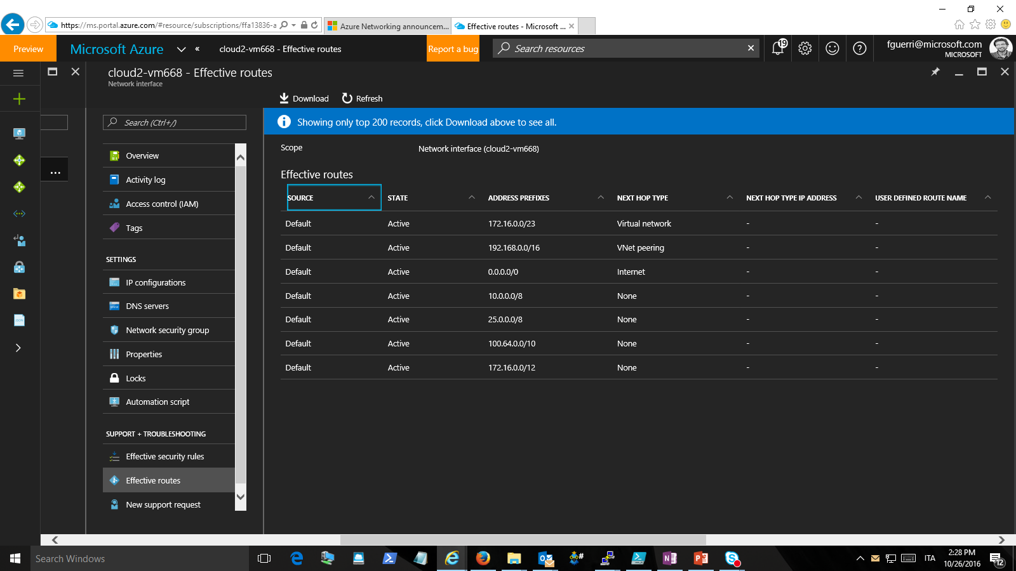
Troubleshooting UDRs

Slide 186
Network Virtual Appliances

Slide 187
Network Virtual Appliances
IaaS VMs that implement network functions
Firewalls
Application firewalls
IDS/IPS
Load balancers
VPN terminators
WAN optimization
Azure features that enable NVA scenarios
IP Forwarding: enables a VM to receive packets whose destination address is different than its own
UDRs: allow overriding a VNet‘s default routing behavior (next-hop can be a VIP in an Azure LB)

Slide 188
Network Virtual Appliances
How many NICs?
From Azure’s standpoint, one is enough, but 3rd party NVAs might require more
When only one NIC is used, the NVA must be deployed to its own dedicated subnet
Name: VNet1
Address space: 10.57.0.0/16
UDR
UDR
Subnet1
10.57.1.0/24
Subnet2
10.57.2.0/25
NVA-Subnet
10.57.3.0/27
In a VNet, a VM does not need to have a NIC in a subnet in order to send traffic directly to that subnet (different from physical networks)
VM1
VM4
NVA
VM5
VM2
Switch/router (Azure VM Switch)

Slide 189
Network Virtual Appliances
How many NICs?
In order to enable more scenarios, NVAs can be deployed with multiple NICs in different subnets
Name: VNet1
Address space: 10.57.0.0/16
UDR
UDR
Subnet1
10.57.1.0/24
Subnet2
10.57.2.0/25
Subnet3
10.57.3.0/27
NVA configuration is the same as in a physical network (i.e. this approach is compatible with a broad range of appliances)
VM1
VM4
VM5
VM2
NVA
Switch/router (Azure VM Switch)

Slide 190
Native high availability
Most Azure Virtual Network features are natively HA
Load balancers
Application gateways
Virtual Network Gateways
The underlying VM Switch (UDRs, NSGs,…)
Network Virtual Appliances are not natively HA
NVA are just IaaS VMs
HA NVAs: two NVAs deployed in an availability set…
… but HSRP/VRRP do not work in Azure (L2/L3 broadcast/multicast not possible in a VNet)

Slide 191
HA for NVA
Active-Passive with UDR update
UDR configure dto send traffic to NVA1
Name: VNet1
Address space: 10.57.0.0/16
UDR
UDR
Subnet1
10.57.1.0/24
Subnet2
10.57.2.0/25
NVA-Subnet
10.57.3.0/27
VM4
Availability Set
VM1
NVA1
VM5
VM2
NVA2
Switch/router (Azure VM Switch)

Slide 192
HA for NVA
Active-Passive with UDR update
Name: VNet1
Address space: 10.57.0.0/16
UDR
UDR
Subnet1
10.57.1.0/24
Subnet2
10.57.2.0/25
NVA-Subnet
10.57.3.0/27
VM1
VM4
NVA1
VM5
Active NVA goes offline
VM2
NVA2
Switch/router (Azure VM Switch)

Slide 193
HA for NVA
Active-Passive with UDR update
UDR configure dto send traffic to NVA2
Name: VNet1
Address space: 10.57.0.0/16
NEW
UDR
NEWUDR
Subnet1
10.57.1.0/24
Subnet2
10.57.2.0/25
NVA-Subnet
10.57.3.0/27
VM1
VM4
NVA1
VM5
Secondary appliance detects failure and triggers UDR update
VM2
NVA2
Switch/router (Azure VM Switch)

Slide 194
HA for NVA
Active-Passive with UDR update
Name: VNet1
Address space: 10.57.0.0/16
NEW
UDR
NEWUDR
Subnet1
10.57.1.0/24
Subnet2
10.57.2.0/25
NVA-Subnet
10.57.3.0/27
VM1
VM4
NVA1
VM5
New UDR installed; traffic flows to secondary appliance
VM2
NVA2
Switch/router (Azure VM Switch)

Slide 195
HA for NVA
Active-Active with load balancing + SNAT
UDR configured to send traffic to ILB
Name: VNet1
Address space: 10.57.0.0/16
UDR
Subnet1
10.57.1.0/24
Subnet2
10.57.2.0/25
NVA-Subnet
10.57.3.0/27
VM1
VM4
NVA1
VM5
ILB
ILB sends traffic to NVA1, which SNATs connection behind its own IP
VM2
NVA2
SNAT
Switch/router (Azure VM Switch)

Slide 196
HA for NVA
Active-Active with load balancing + SNAT
UDR configured to send traffic to ILB
Name: VNet1
Address space: 10.57.0.0/16
UDR
Subnet1
10.57.1.0/24
Subnet2
10.57.2.0/25
NVA-Subnet
10.57.3.0/27
VM1
VM4
NVA1
VM5
ILB
ILB sends traffic to NVA2, which SNATs connection behind its own IP
VM2
NVA2
Switch/router (Azure VM Switch)
SNAT

Slide 197
HA for NVA
Active-Active with load balancing + SNAT
As of today, this approach works only when the backend VMs expose selected endpoints
Reason: load balancing rules are port-specific

Slide 198
Azure DNS
https://azure.microsoft.com/en-us/services/dns/

Slide 199
Azure DNS key features
All common DNS record types
A, AAAA, CNAME, MX, NS, SOA, SRV, TXT
PTR coming soon—in the meantime, hosting ARPA zones is not supported
Wildcard records
Fast and available
Low query latency from global Anycast network of name servers
Fast propagation of new records
High availability control plane—resilient to regional failure
Azure Resource Manager benefits
Security, role-based access control, tagging, and template-based deployment
ARM-only service (no ASM support)

Slide 200
Azure DNS Latest Announcements
https://azure.microsoft.com/en-us/roadmap/azure-dns-generally-available/

Slide 201
Network Automation

Slide 202
Network Automation in Azure
Leverage Rich Azure rich SDKs and APIs
ARM Templates (Infrastructure as Code): https://github.com/Azure/azure-quickstart-templates
Azure SDKs: https://docs.microsoft.com/en-us/azure/#pivot=sdkstools
Azure CLI 2.0 (Mac, Linux and Windows)
Azure PowerShell module
Azure Automation: orchestrator natively in Azure
Azure Functions: automation scripts from the cloud

Slide 203
Network Monitoring in Azure

Slide 204
Network Monitoring in Azure - Overview
Azure Monitor
Azure Network Watcher
OMS solutions
Azure Network Performance Manager
NSG Analytics
App Gateway Analytics
Deep analysis of these solutions out of the scope of this presentation

Slide 205
E2E Monitoring Experience on Azure
Azure Portal
3rd party products, integrate via REST API, Event Hub, Storage log files
Azure Monitor
(platform monitoring)
Application Insights (Application monitoring)
Log Analytics, Automation, Solutions (OMS)
On-prem, hybrid/ external cloud data
Azure services

Slide 206
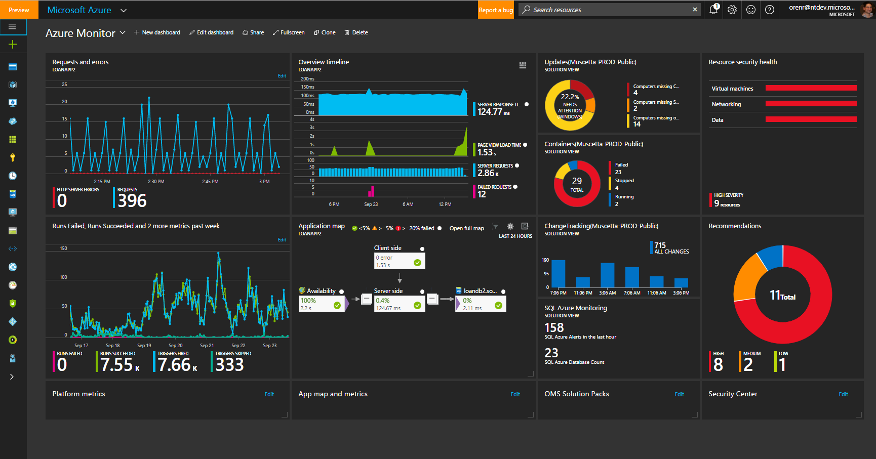
Azure Monitor - Dashboard
Platform Monitoring
Application Monitoring
OMS Solutions
Security Center
Notes:
Here’s an example dashboard. In one pane of glass I have platform monitoring, application monitoring, solutions from OMS providing me deeper insights into my data, and in this example I have Security center recommendations pinned.

Slide 207



Network Performance Monitor Overview
Network Performance Monitor (NPM) monitors connections between office sites, data centers, clouds and applications. NPM offers near real time monitoring of network performance parameters like loss and latency. It not only detects network problems but helps you to quickly locate the source of the problem for easy troubleshooting.
Loss & Latency
Synthetic Transactions
Network - A
Network - B

Slide 208











Network Performance Monitor Overview
Architecture
Features
OMS
Network device vendor agnostic
Measures packet loss and network latency
Fault Detection & Localization
Automatically learns baseline thresholds.
Automatically discovers the subnets and network topology
Historical graphs of loss and latency
Integrates with OMS search for easy analytics and reporting
Works in cloud, on premise or hybrid environments
10.10.1.0/24
10.10.2.0/24
10.10.4.0/24
Allows custom alert rule creation
NPM Agents

Slide 209

Azure Network Watcher
Topology
Network Diagnostics
Metric
Logs
Visualize your network topology
Diagnostic tools for networking related issues
Measure and view your network performance and health
Configure and view your logs
Topology
Variable Packet Capture
IP Flow Verify
Security Group View
Next Hop
VPN Diagnostics
Network Subscription Limits
Network Security Flow logs
Single place to configure all logs and Alerts

Slide 210
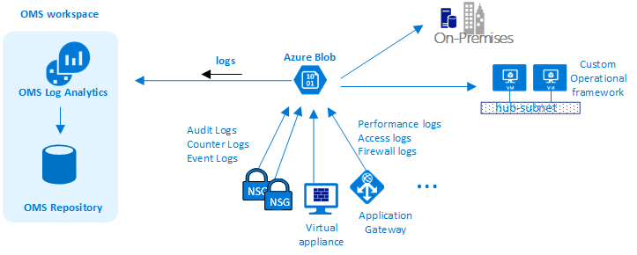
OMS Log Analytics
https://docs.microsoft.com/en-us/azure/virtual-network/virtual-network-nsg-manage-log

